Slide 1

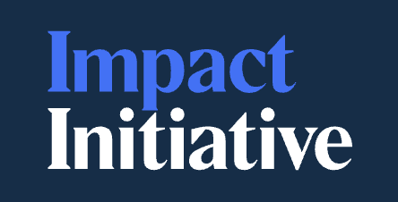
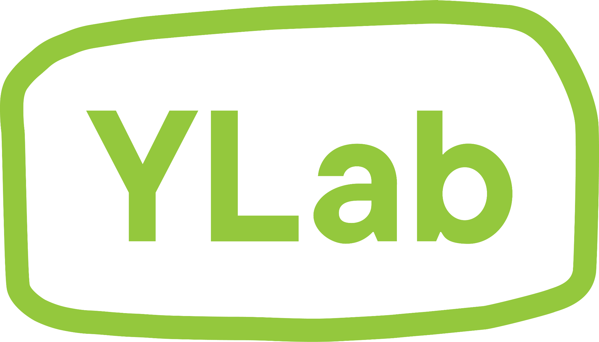


What Are Children and Young People,
in the Eyes of the System?
Moderators
Dr. Bengianni Halil-Pizzirani, Managing Director of Research & Evaluation, Impact Initiative & Co-Founder, synk.ai
Imogen Gerraty, Co-CEO, YLab
Panelists
Deb Tsorbaris, National Children’s Commissioner
Sue-Anne Hunter, National Commissioner for Aboriginal and Torres Strait Islander Children and Young People
Chris Collett, Acting Deputy Secretary, Justice and Communities Group, Attorney-General’s Department, Australian Government

Slide 2

Every system carries an idea of children and young people within it.
That idea is reflected in how systems:
define need and risk
decide who is eligible for support
assess and measure outcomes
fund and commission services
include children and young people in decisions
distribute responsibility and accountability
The way we understand children and young people shapes the systems we build around them.

Slide 3
How systems see children and young people matters
If we see them mainly through risk, we build around assessment and management. If we see them mainly through services and eligibility, we divide their lives into programs and categories. If we see them mainly as future adults, we can lose sight of their experience now.
What the system sees shapes what it notices, funds, measures and responds to.
As you listen: What version of the child or young person does your system appear to assume?

Slide 4
A fuller understanding of children and young people
Developmental
Developing and changing across time
Relational
Embedded in relationships, family and kin
Rights-bearing
Entitled to safety, dignity, participation and voice now
Culturally located
Shaped by culture, Country, community and history
A fuller account should change what systems are designed to see, value and act on.
As you listen: Which parts of children and young people’s lives are easiest for systems to see, and which are easiest to lose?

Slide 5
Three perspectives on children
and young people
Sue-Anne Hunter
National Commissioner for Aboriginal and Torres Strait Islander Children and Young People
Relationship, culture, family, kin, Country and belonging
Deb Tsorbaris
National Children’s Commissioner
Rights, recognition and accountability
Chris Collett
Acting Deputy Secretary, Justice and Communities Group, Attorney-General’s Department
National policy, child safety and system architecture

Slide 6
Opening Proposition
What is the system currently getting right about how it sees children and young people?
As you listen: What is worth preserving before we start asking what needs to change?

Slide 7
Sue-Anne Hunter
Relationship, culture, family, kin, Country and belonging
Children and young people are shaped by the relationships, cultures, histories and communities within which their lives are lived.
What would change if our starting point was that a child or young person cannot be understood apart from relationship, culture, Country, family, community and history? What would our current systems have to see differently?

Slide 8
Deb Tsorbaris
Rights, recognition and accountability
The way systems fund, assess, measure and intervene reveals the assumptions they make about children and young people.
If we worked backwards from the way our systems fund, assess, measure and intervene, what would that tell us about the child or young person they assume? Is that child primarily vulnerable, at risk, a future adult, a service user, a rights-holder, or something else?

Slide 9
Chris Collett
National policy, child safety and system architecture
A fuller understanding of children and young people only matters if it is carried consistently through policy, regulation, accountability and practice.
From a national system perspective, what would a future look like where a fuller understanding of the child and young person is embedded in policy, regulation, accountability and practice, and reflected consistently in how different parts of government work together?

Slide 10
Second Proposition
A fuller understanding of children and young people only matters if it changes how systems are designed, how decisions are made, how responsibility is organised and how success is judged.
As you listen: Where is the biggest gap between how systems describe children and young people and how those systems behave?

Slide 11
FOR THE ROOM
What are children and young people, in the eyes of the system in your context?
Consider the systems you work within:
If you worked backwards from how they actually operate, what would they tell you about the children and young people those systems assume?
Think system behaviour, not stated intent.

Slide 12
FOR THE ROOM
What should this panel confront?
Having heard the three perspectives:
What is one question we should confront about how systems see, understand and respond to children and young people?
Bring us the question you think the room should leave with.

Slide 13
Takeaway
If there is one thing you would like people in this room to take away from this conversation, it is…

Slide 14
From seeing differently to building differently
How we understand children and young people shapes the systems we build around them.
A fuller account is developmental, relational, rights-bearing and culturally located.
What would it take for that understanding to shape the rules, decisions and accountabilities of the systems around them?

