Slide 1

What have we learned from implementing inspire in
LMICs ?
Bernadette J. Madrid, MD
Executive director child protection Network foundation,Inc.

Slide 2


Slide 3
Raise your hand if you come from a country that has adopted
INSPIRE or incorporated it into the national strategy?

Slide 4
Objectives
1. Examine key lessons learned from implementing INSPIRE in low- and middle-income countries
2. Identify priority actions for strengthening the next phase of INSPIRE implementation

Slide 5
Use existing delivery platforms whenever possible

Slide 6
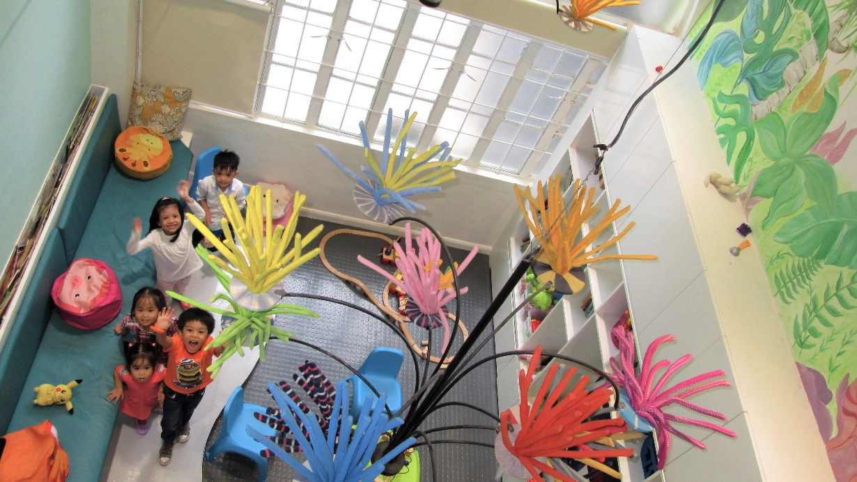
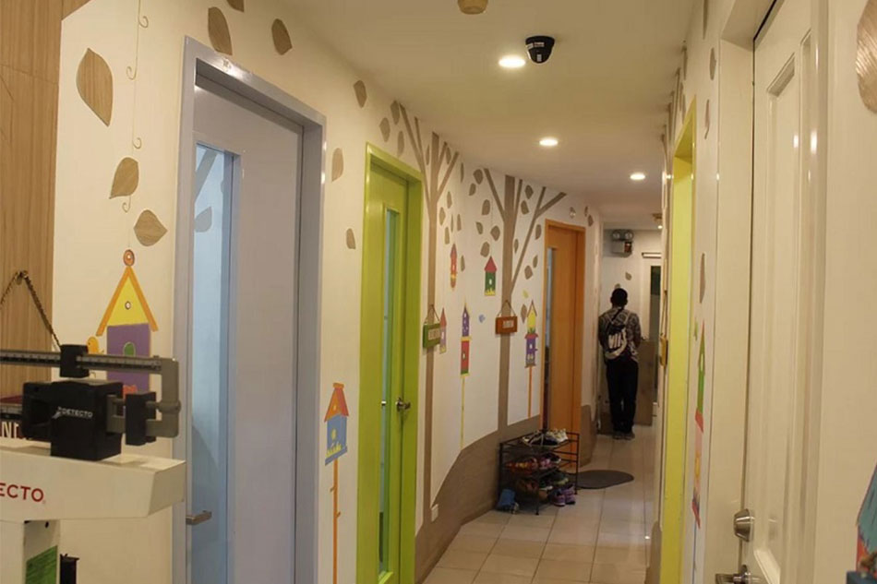
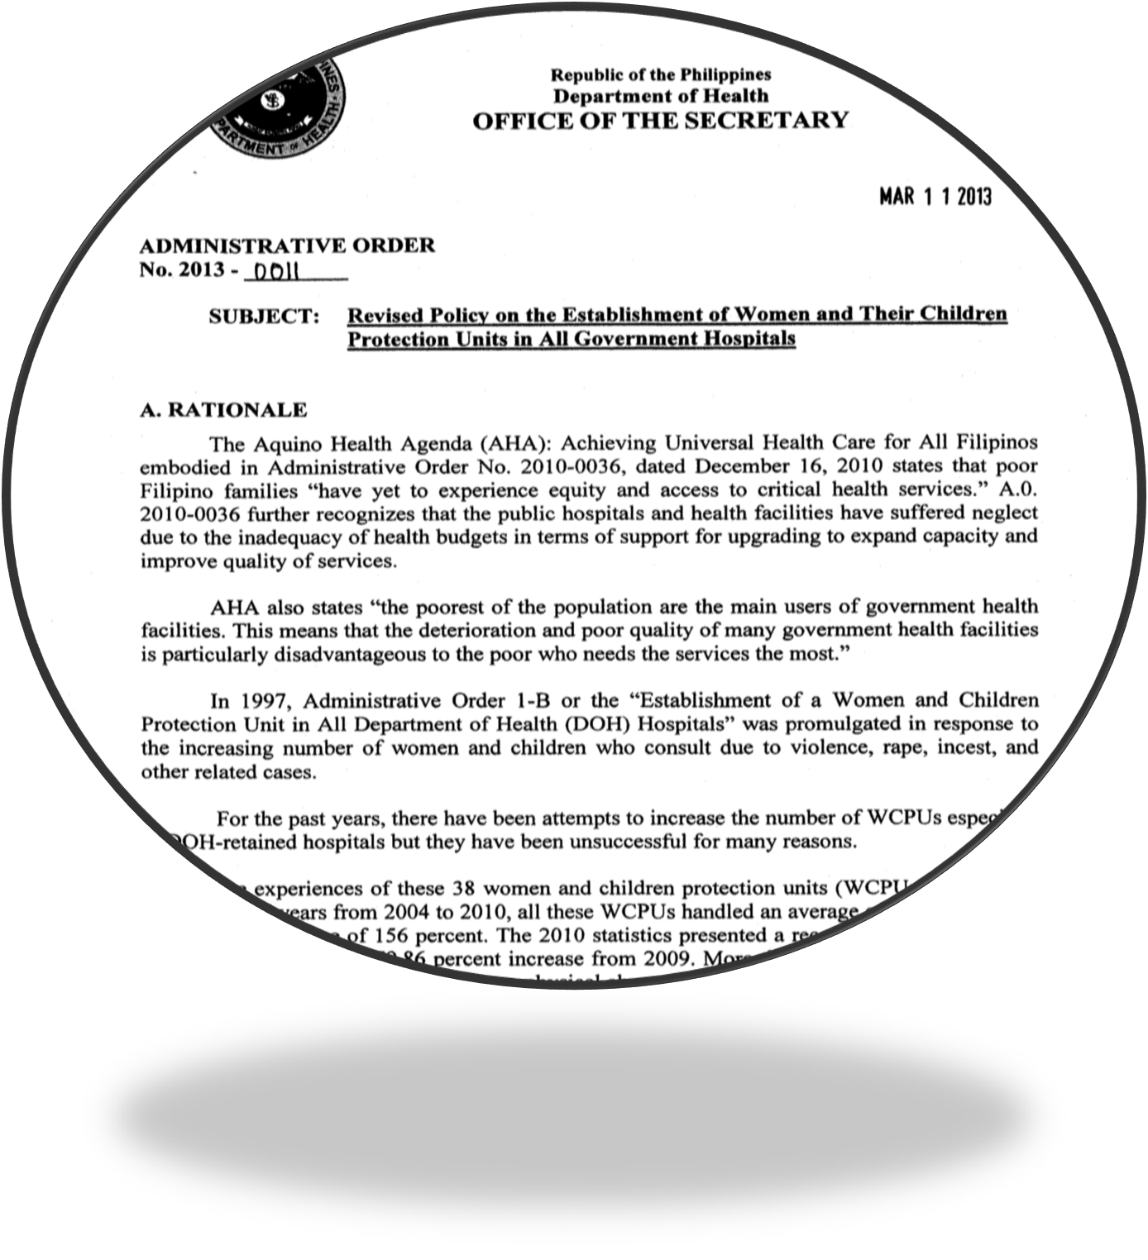


Women and Children Protection Units
The WCPUs are child and gender-friendly units using a multidisciplinary approach in providing integrated medical, psychological, social and legal services to women and children survivors of violence.
The WCPUs are part of hospital services.
The WCPUs are operated through a partnership between the Child Protection Network, the Department of Health and the local government units.

Slide 7
173 Women and Children Protection Units in 70 Provinces

Slide 8
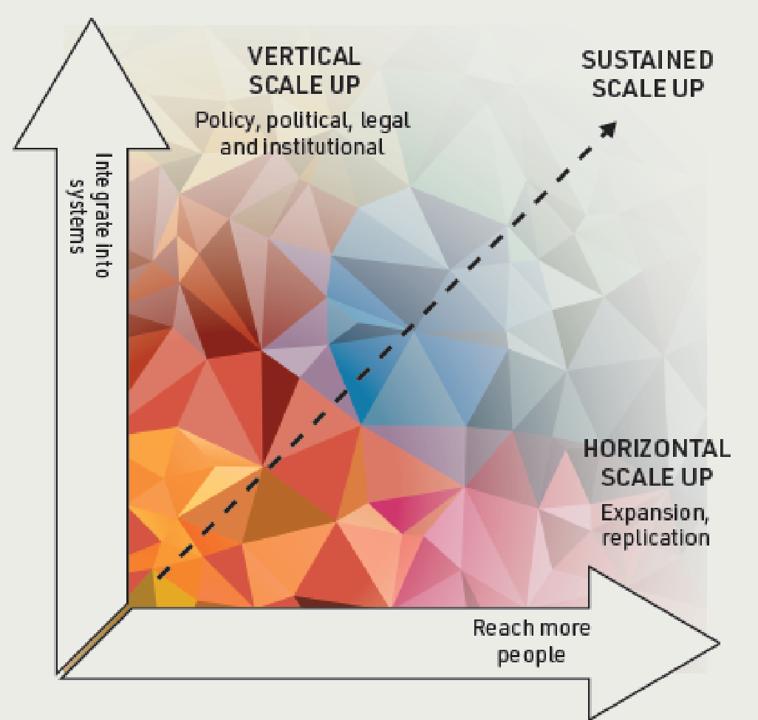
SCALING UP FOR IMPACT
INSPIRE Working Group. (2021) INSPIRE Guide to Adaptation and Scale-Up. New York: INSPIRE Working Group; 2021.
Notes:
Vertical and horizontal scaling of interventions based on the best-available evidence are both essential. Vertical scaling (that is, ensuring that a country’s policy, budgetary, administrative, training, and service-delivery systems will support regional or national dissemination) should always be a critical goal, since it is through vertical scaling that economies of scale can be achieved, and the likelihood of sustainability is increased. Failing to get the early buy-in that vertical scaling promotes leaves us with too many semi-scaled interventions that remain donor dependent with no exit strategy. But vertical scaling is difficult and takes many years of active government engagement. Starting with some degree of horizontal scaling may be more feasible where commitment is limited. Horizontal scaling can be valuable in documenting the effectiveness of an intervention in diverse settings and in helping to understand the opportunities and challenges to its delivery in different settings. Such information can then be used to advocate for the vertical scale up of interventions which do prove effective.

Slide 9

What is the biggest bottleneck in implementing INSPIRE in your country?

Slide 10
The workforce is usually the implementation bottleneck

Slide 11
Medical Training Continuum
on Women & Children Protection
CPN, UP Manila, DOH, PNP
Women and Children Protection
Ladder Curriculum
Specialty Societies
Obstetrics & Gynecology Residency
Pediatrics Residency
Ambulatory Pediatrics Fellowship
Academe
Undergraduate
Medical Curriculum

Slide 12
Social Work Training Continuum
on Women & Children Protection
CPN, IJM, Partners
Specialized training
Therapist (TIPP)
CPN, UP Manila, DOH
Women and
Children Protection
Ladder-curriculum
DSWD, Partners
Generalist
In-service training
Academe
Undergraduate
B.S. Social Work

Slide 13
Political commitment must translate into budgets

Slide 14
Program Sustainability
Laws, Policies, Institutional & Political support | Funding Support
R.A. 9262 (Anti Violence Against |Women & their Children), RA 11596 (Anti Child Marriage), R.A. 11930 (Anti Online Sexual Abuse and Exploitation of Children) | National Strategic & Costed Implementation Plan for the Women and Children Protection Program of the Department of Health
Department of Health Administrative Order 2013-0011 | Gender and Development Fund of the government Philippine Health Insurance coverage –Outpatient emergency care benefit (Dec 2024)
Local Legislative Assembly approval of the MOA between Local Gov’t Units & CPN | Local government units budget, UN agencies, International NGOs, Civic Organizations, private donors
Champions in Congress- SB 2401 (Institutionalizing the establishment of WCPUs in government hospitals) | Plantilla positions for WCPU personnel in the hospital through the General Appropriations Act

Slide 15
INSPIRE works best as an integrated package

Slide 16





Working in silos

Slide 17



INSPIRE is not seven programs- It is a system

Slide 18
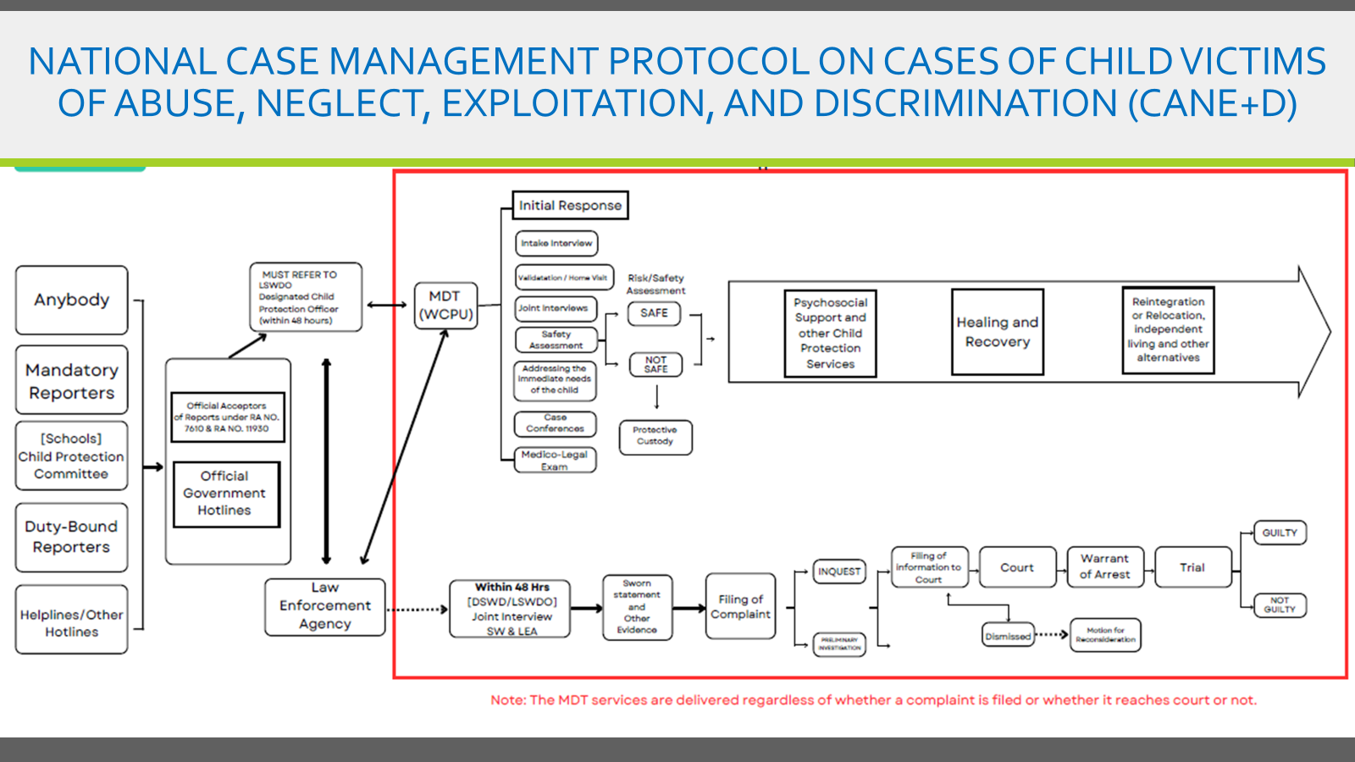

Slide 19
Multi sectoral coordination requires authority & accountability

Slide 20
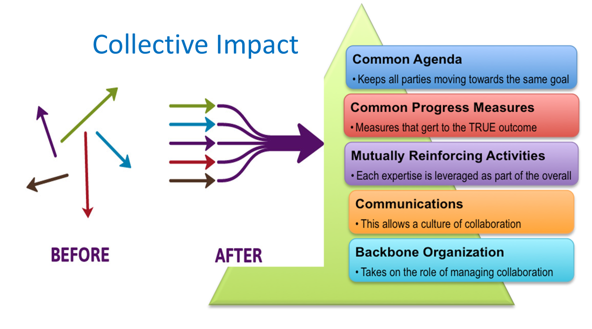

Slide 21
Steering Overall
Policy-making
Department of
Social Welfare &
Development
NGO
Representation
Department of
Justice
Research
Judiciary
Commission on
Human Rights
Philippine National
Police
Department of Labor & Employment
Monitoring and
Evaluation
Council for the Welfare of Children
Presidential Office for
Child Protection
National Bureau
Investigation
Training and Capacity
Building
ECCD
Academe & Expert Bodies
Department of
Education
Department of
Health
Department of
Interior and Local Government
Business sector
Department of
Tourism
Advocacy
Planning

Slide 22
Who is accountable for reducing violence
against children in your country?

Slide 23
Decentralization is both an opportunity and a risk

Slide 24

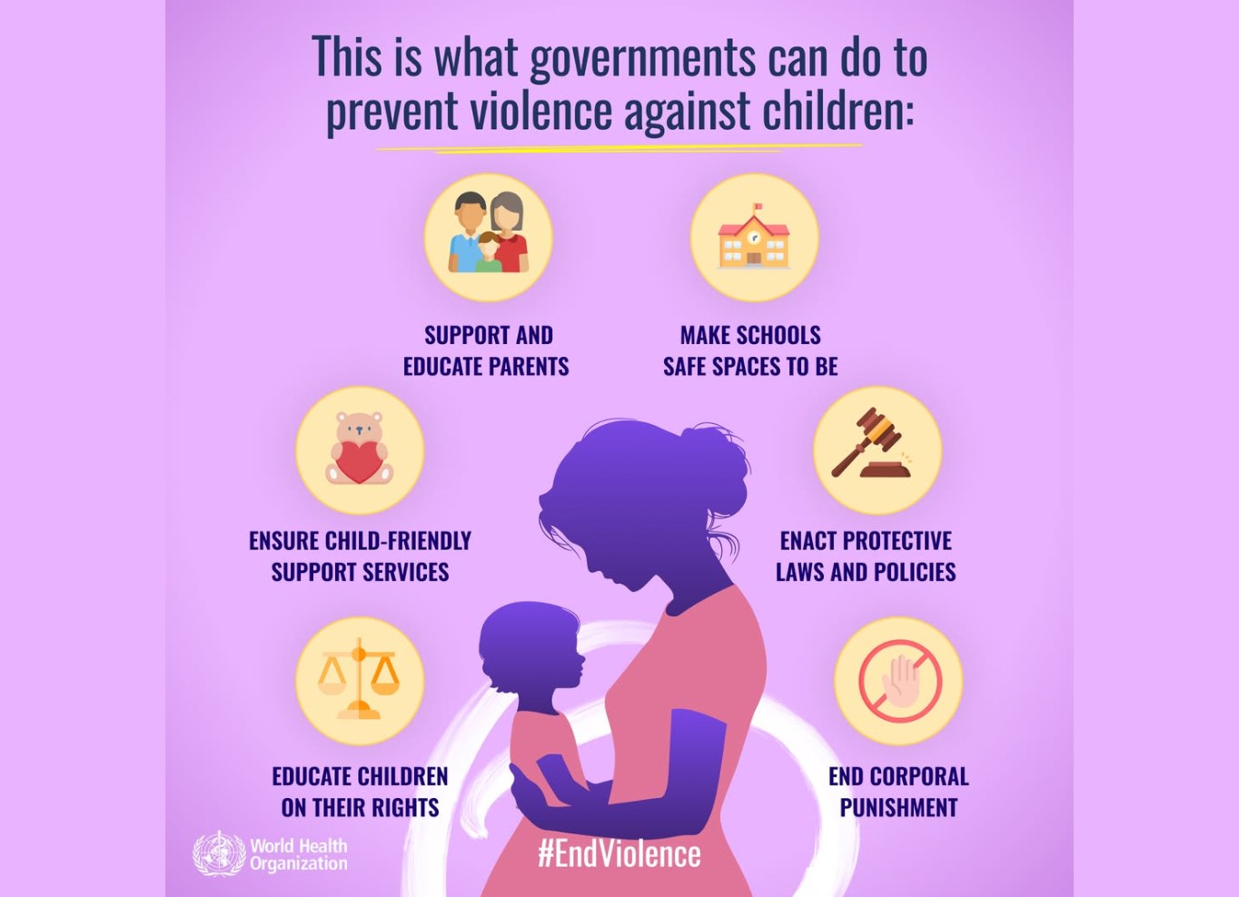

Slide 25


Slide 26
What should we be doing differently to implement
INSPIRE in the next decade?

Slide 27


Slide 28
Thank you

