Slide 1

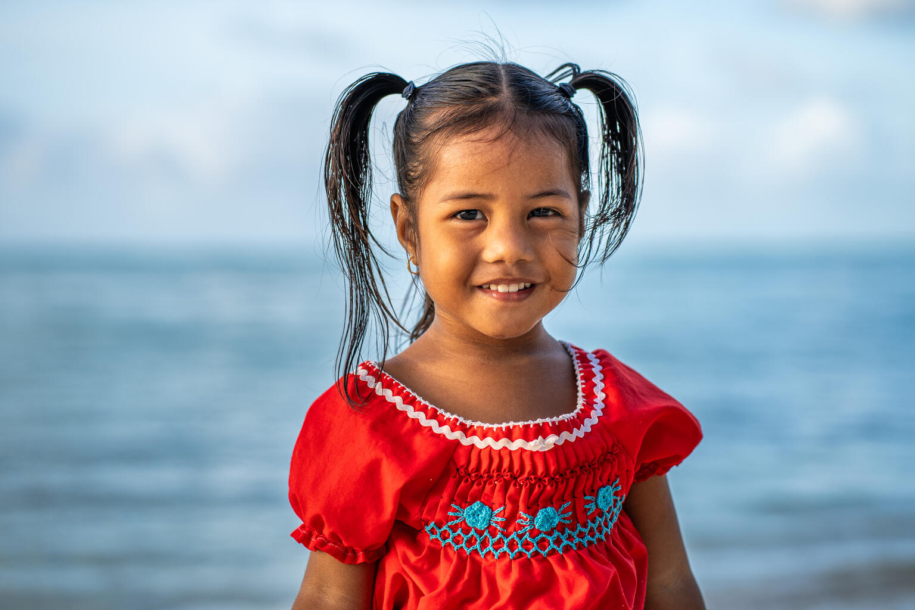
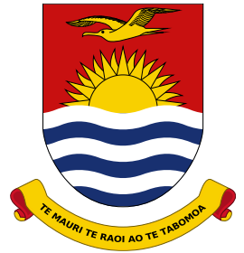
Kiribati child protection system
MWYSSA
30/07/ 2026

Slide 2
Key Focus
Overview of Kiribati and the Child Protection System
Key Child protection challenges
Strengths and progress

Slide 3
KIRIBATI • COUNTRY CONTEXT
Geography and demography shape child protection delivery
A widely dispersed island nation, a young population and strong community networks shapes how services organized.
GEOGRAPHY
POPULATION • 2020 CENSUS
COMMUNITY & CULTURE
33
119,438
Children are supported through close family and community networks.
islands across the Central Pacific
people nationwide
41%
aged 17 or younger
• Extended families play a central caregiving role
• Churches and traditional leaders influence community support
• Traditionally patriarchal structures shape family and community decision-making
32 low-lying coral islands and Banaba
21 inhabited islands
Three island groups: Gilbert, Phoenix and Line Islands
53%
live in South Tarawa and Betio
Sources: Kiribati NSO and SPC, 2020 Census
8

Slide 4
KIRIBATI • CHILD WELLBEING SNAPSHOT
Children face overlapping protection and development challenges
The indicators point to high exposure to harmful discipline alongside widening gaps in education, nutrition and early development.
PROTECTION
EDUCATION
HEALTH & DEVELOPMENT
92.1% of children aged 1-14 experience violent discipline
School attendance
30%
41.6% of mothers believe physical discipline is ok
95.8% Primary
of children are stunted
80.5% Lower secondary
20.4% of women marriage before the age of 18
3.5 months
54.7% Upper secondary
24.4% 15-17 yrs engage in child labor
average breastfeeding duration
(down from 6 months)
↓ 10% literacy & numeracy
2017–2024
Source: MICS 2019
Sources: MICS 2019; KiEHCI 2024
1

Slide 5
Kiribati CHILD PROTECTION SYSTEM
A national system built on leadership, law and coordination
LEGAL & POLICY FOUNDATIONS
LEADERSHIP & CAPACITY
A strong national framework
29
• Children, Young People and Family Welfare Act 2013
• Kiribati Early Childhood Development Policy 2022–2032
• Positive Parenting Strategy 2026–2028, approved by Government
social welfare personnel serving across Kiribati
COORDINATION & REFORM
Multi-sectoral mechanisms connect policy to practice
MWYSSA, through the Social Welfare Division, is the lead government agency for child protection.
A national technical working group and the Child Protection Referral Pathway coordinate health, education, police, NGOs and communities.
UNICEF provides technical and financial support.
Current reforms: Youth Justice Bill
Development: Minimum Standards for Counselling & MHPSS Policy
2
Notes:
MWYSSA through the social welfare division is the leading child protection agency in Kiribati.

Slide 6
KIRIBATI CHILD PROTECTION CHALLENGES
Geography and limited capacity constrain service delivery
Outer-island access, workforce shortages and weak system enablers make consistent child protection coverage difficult.
WORKFORCE CAPACITY
OUTER-ISLAND ACCESS
One officer may carry an island-wide caseload
Distance raises both cost and response time
Assistant Social Welfare Officers balance routine duties with child protection responsibilities.
specialized child protection workers remain limited.
• Limited equipment
• Weak infrastructure
• Few child-friendly and safe spaces
Culture: Social acceptance of physical discipline remains widespread, while limited child protection data continues to constrain planning, monitoring and investment.
These gaps are most acute on outer islands.
3

Slide 7
KIRIBATI CHILD PROTECTION STRENGTHS
Strong foundations support coordinated child protection
Kiribati combines legislation, response mechanisms, social protection and community leadership.
A broad legal and policy framework
PROTECT
• Children, Young People and Family Welfare Act
• Child labour regulations, including hazardous-work protections and light-work rules
• Family Peace Act and Minimum Standards for Counselling
• Youth Justice reform through the Youth Justice Bill
Laws & standards
National mechanisms connect cases to support
RESPOND
• Child Protection Referral Pathway and 24/7 child helpline
• SafeNet case-management review committee and national multi-sectoral technical working group
• Three social protection programmes: SFU, SCA and DSA
Services & coordination
Families and communities are central to prevention
PREVENT
Family and community support for children’s wellbeing and schooling • Kiribati Men’s Behavioural Change programme (KMBC), young couple program, ongoing child right community awareness
Information supplied by presenter
4

Slide 8
COMMITMENT TO SIX SYSTEM STRENGTHENING PILLARS
Progress in policy and the prevention–response continuum
01
POLICY & LEGISLATION
02
PREVENTION & RESPONSE
The legal framework continues to expand and modernize.
Services combine immediate response with sustained prevention.
• Child Protection Referral Pathway endorsed by Government in 2018
• National Positive Parenting Strategy 2026–2028 approved in July 2026
• Children, Young People and Family Welfare Act 2013
• Juvenile justice reform through the Youth Justice Bill
• Minimum Standards for Counselling under development
• MWYSSA provides a 24/7 child protection response
• Free child helpline
• Continued rollout of the Referral Pathway, Child Rights and Young Couples programmes
• Ongoing parent and community education on positive parenting
• Partnerships support coordinated child protection programmes
Information supplied by presenter
5

Slide 9
COMMITMENT TO SIX SYSTEM-STRENGTHENING PILLARS
Participation and coordination bring protection closer to communities
03
PARTICIPATION IN SOLUTIONS
04
GOVERNANCE & COORDINATION
CHILD • SURVIVOR • COMMUNITY
NATIONAL • ISLAND • COMMUNITY
The child’s best interests remain central to case management
Coordination structures link national leadership to every island.
• Decisions and interventions are guided by the best interests of the child.
• Church partners help strengthen community implementation of child protection initiatives
• A national Child Protection Technical Working Group supports multi-sectoral coordination.
• Child protection working committees operate on outer islands.
• Assistant Social Welfare Officers lead child protection coordination on islands across Kiribati.
Information supplied by presenter
6

Slide 10
COMMITMENT TO SIX SYSTEM-STRENGTHENING PILLARS
Data and workforce priorities strengthen national delivery
05
DATA-DRIVEN SOLUTIONS
06
CAPACITY & SCALED SOLUTIONS
COLLECT • CONNECT • USE
NATIONAL PRIORITIES • 2025–2027
Existing databases provide a foundation, but data quality must improve.
National priorities invest in people, policy and proven programmes.
• The Gender-Based Violence Database records reported GBV cases.
• A child protection database supports case information and reporting.
• Persistent gaps in completeness, consistency and use of data continue to limit planning and monitoring.
CPD for all social workers across Kiribati
• Implementation and scale-up of rehabilitation and positive-parenting programs, and continue child protection community awareness
Continue strengthen and support CPWG
• Development of the national MHPSS Policy
• Strengthen counselling services (child counselling)
7
Notes:
Case management and supervision training in October – new trainings for new social workers and refresher training for old aswos

Slide 11

Thank You
KAM RABWA

