Slide 1



Responsible and ethical AI in child and family
services

Slide 2



Acknowledgement of Country
We acknowledge the Traditional Custodians of the lands and waterways on which we live and work, the Wurundjeri people of the Kulin Nation.
We pay our respects to Elders past and present, and we honour their enduring strength and aspirations for the future of their young people, communities and lands.

Slide 3
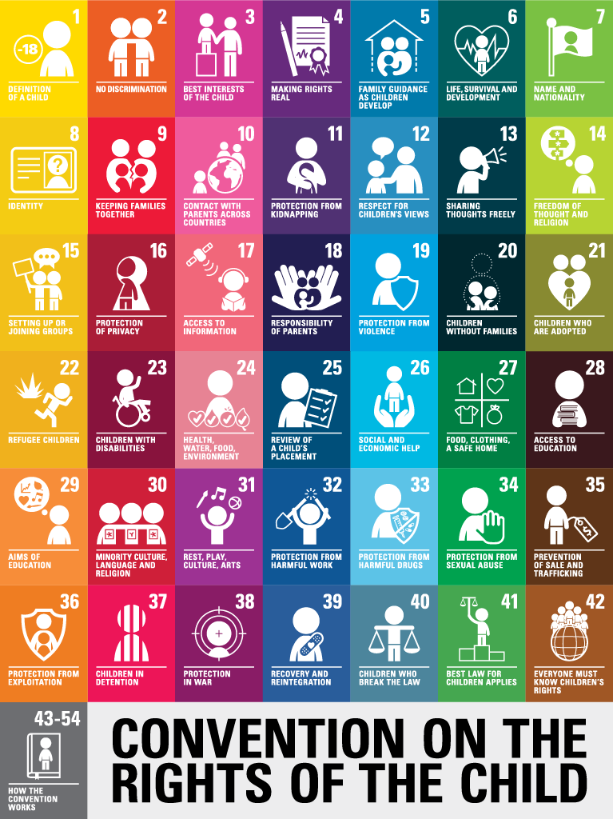
UN Convention on the Rights of the Child
The United Nations Convention on the Rights of the Child is an important agreement by countries who have promised to protect children’s rights.
The Convention on the Rights of the Child explains who children are, all their rights, and the responsibilities of governments. All the rights are connected, they are all equally important and they cannot be taken away from children.
Notes:
Key Message: UN Conventions on the Rights of the Child (5 mins)
Speaker Instructions:
The UNCRC is an international treaty adopted in 1989, ratified by almost every country, including Australia. It sets out 54 articlesthat define children’s rights in areas like survival, development, protection, and participation.
It’s legally binding and forms the foundation for child-focused legislation and policy. Article 12 (right to be heard) and Article 3 (best interests of the child ).
Why It Matters
The Voice of the Child is embedded in the UN Convention on the Rights of the Child (Article 12), which affirms every child’s right to express their views and have those views taken seriously.
In Victoria, this principle is reflected in the Best Interests Case Practice Model, which places the child’s perspective at the centre of assessment, planning, and review.
Core Principles of the UNCRC
There are four guiding principles: Non-discrimination– Every child has equal rights.
Best interests of the child– Decisions must prioritize the child’s welfare.
Right to life, survival, and development – Holistic well-being is essential.
Respect for the views of the child – Children have the right to be heard.
These principles should underpin all our interactions and documentation.

Slide 4
Welcome to our panel
Dr Amanda Caples
Victoria’s Lead Scientist, Department of Jobs, Skills, Industry and Regions
David Poynter
Director Evidence & Research | Business Development and EBM
Anglicare Victoria
Mark Davis
Human-Centred Designer, Today

Slide 5

Framing questions
1. What is so genuinely different about artificial intelligence compared with previous technological advances, and why does this matter for children, families and communities?
2. How can AI be applied responsibly, ethically and equitably across child and family services, and what governance and co-design conditions make this possible?
3. What does a trusted, human-centred approach to AI look like, and how do governments, service providers, designers and communities work together to build it?

Slide 6
Group consideration
What would /does responsible AI in child and family services look like in your context?
What is your organisation’s current policy position, stance or working approach to AI?
How should AI policy be developed collaboratively within organisations and across the child and family services sector?
What are non-negotiable principles for AI adoption?

Slide 7
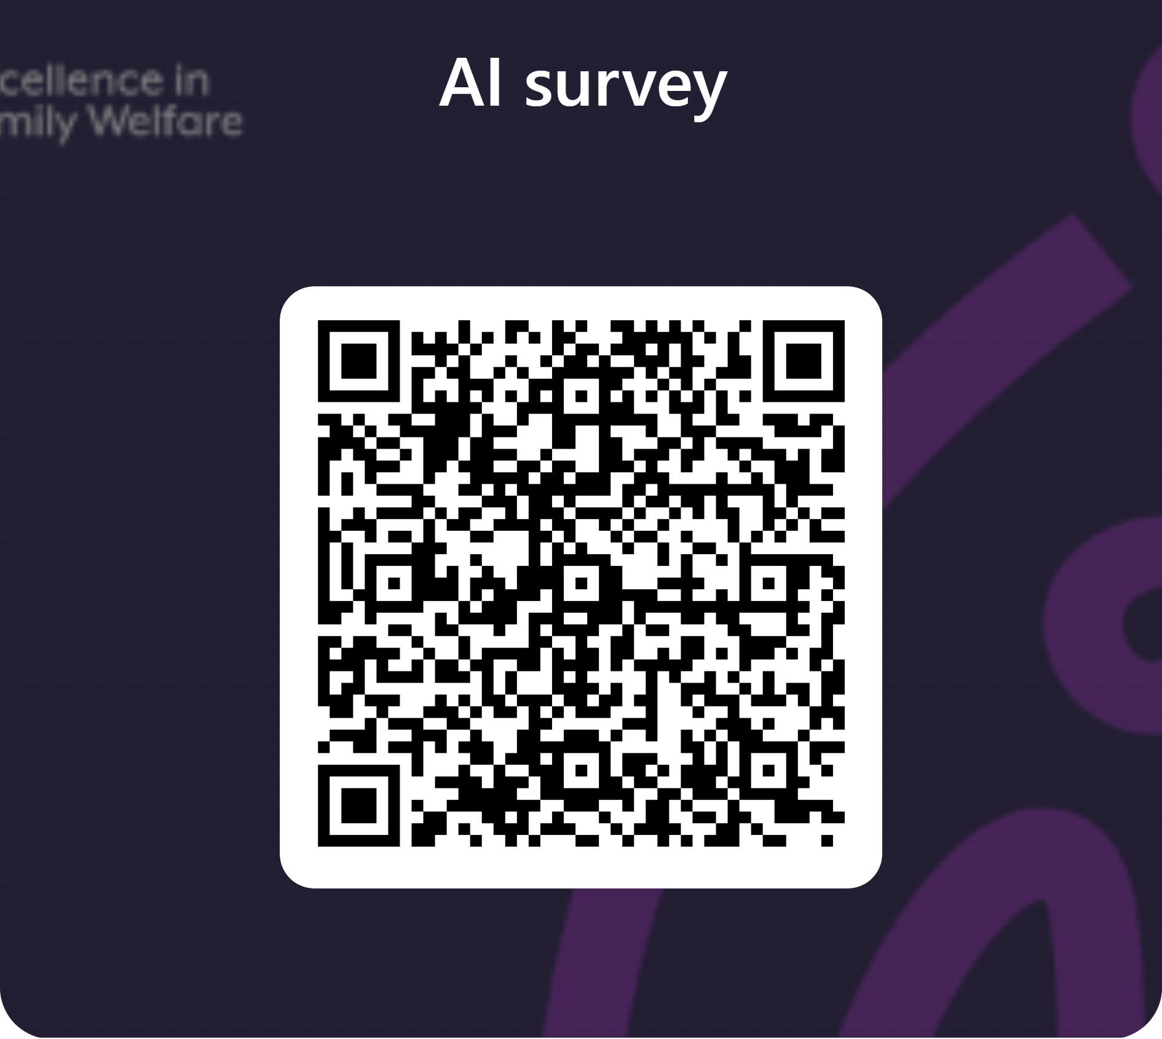
AI Use poll

Slide 8
Guidance for AI adoption: implementation guidance (National Artificial Intelligence Centre, October 2025)
Six practices for responsible AI adoption
1. Decide who is accountable
Establish end-to-end accountability and robust AI governance.
2. Understand impacts and plan accordingly
Ensure stakeholder rights and fair treatment.
3. Measure and manage risks
Implement AI-specific risk management.
4. Share essential information
Ensure appropriate transparency and explainability.
5. Test and monitor
Ensure quality, reliability and protection through evaluation and monitoring.
6. Maintain human control
Integrate meaningful human oversight and control

Slide 9
Post session outputs: from practice to policy
A summary paper capturing and consolidating key issues, insights and practical questions arising from this discussion:
    areas requiring further exploration, guidance or policy development.
    examples of effective practice and implementation approaches.
    actionable considerations to support safe, ethical and effective AI adoption.
    understanding best approaches to the governance, workforce and organisational implications of AI.

