Slide 1
Rise Up Policy Forum:
Child Online Safety in Practice
Chair of Session – Diahann Gordon Harrison
ISPCAN Board Member; Attorney-at-Law; Children’s Advocate of Jamaica & National Rapporteur on Trafficking in Persons

Slide 2
Emerging Evidence and Experience on Bans/Design/Rights:
What Actually Protects Children
Main Focus:
To enable frank and open discussions on the Flavour of the Year: Social Media – to ban or not to ban?!
Session Objectives
To review the emerging evidence on what keeps children safe on social media, including regulation of platform designs, privacy and data protections, age-appropriate safeguards, and any available specific evidence on bans.
To critically examine the case for and against blanket age-based bans – are there any risks of displacement to unregulated spaces, rights trade-offs, risks of isolation to marginalized youth, and impact on platform accountability?
To equip policy makers with more comprehensive, evidence-based options that provide a framework for child online safety that can be adapted to their own jurisdictions.

Slide 3

What problem are we trying to solve?

Slide 4
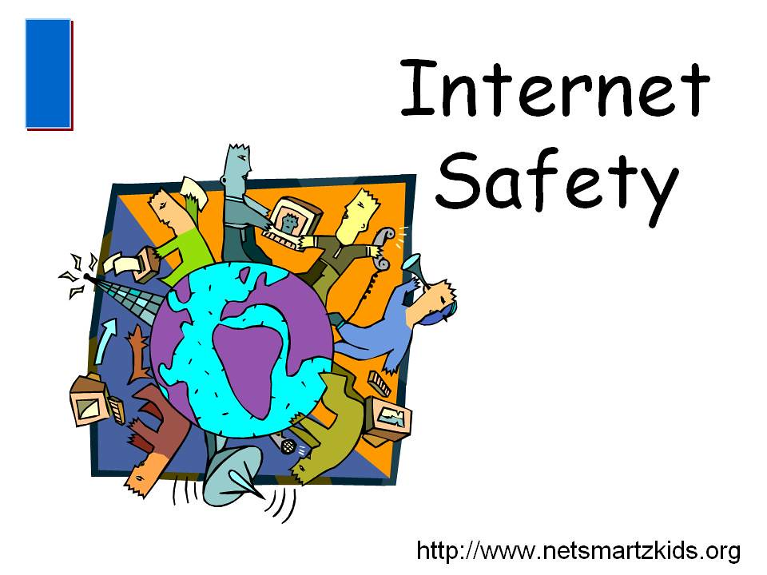
The Problem . . .
How can we keep children safe online?
Inference → Governments/policy makers are coming from a “good” place. They are well-intentioned.

Slide 5

Some of the Concerns
Cyber–bullying
Cyber-trafficking & exploitation
Online predators
Sexual Grooming
Exposure to inappropriate content – accidentally/deliberately access violent, sexual or disturbing material
Online gaming risks – communication with strangers; pressure to make purchases
Oversharing – daily routines, live location, photos can put children at risk
Identity Theft – names, addresses (home/school), passwords can be misused
Scams & fraud – children tricked into giving away passwords or other personal information
Pressure to send private images – manipulation/threats of onward sharing
Addiction & excessive screen time – affects cognitive development/mental health concerns

Slide 6



Slide 7
The Raging Debate . . . Centred around “the How”
The concern centres around the how (not if something should be done) – what measures work?
Is a blanket ban on social media an adequate or appropriate response to online safety concerns?
Blanket Social Media Ban
Strict Prohibition
Variety of Measures
Diverse responses linked to the root

Slide 8
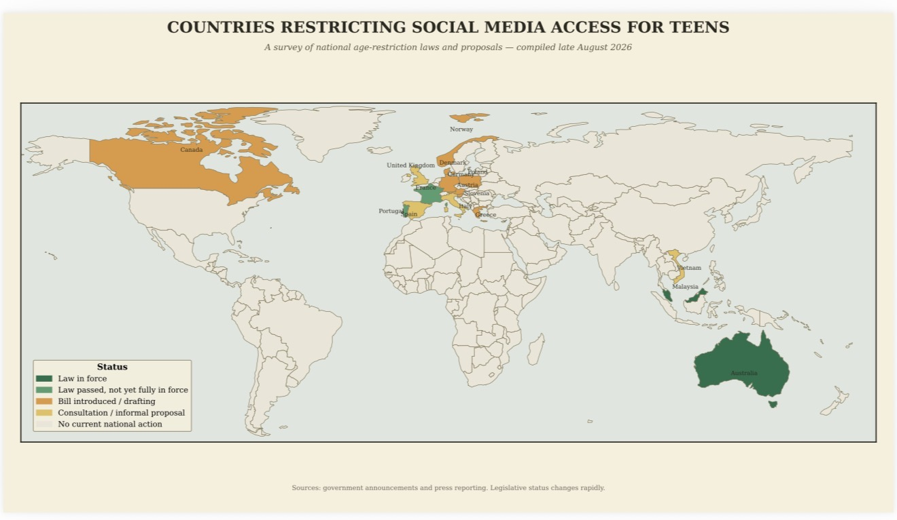

Slide 9

Things to Ponder
Children have the right to participate in decisions that affect them. Were they meaningfully consulted in jurisdictions either with a ban or those moving in this direction?
Children have the right to access appropriate information – current affairs, educational material, health, culture, etc
How does a ban interfere with children’s ability to maintain healthy relationships that serve them well – friends, family, mentors, remote psychosocial support?
Do bans have the potential to trigger mental health concerns – feelings of isolation and abandonment; self-worth; anxiety – consider children in care or single-parent households or acrimonious custody proceedings.
Are bans disrupting children’s sense of belonging, and severing connection or community ties?
Does a ban just drive kids underground by enticing them to migrate to less known and poorly regulated online platforms, unwittingly increasing the same harm that we are trying to protect against?
Does a ban give governments a false sense of security – we did it; we can now relax; we can divert funding.
What about Committee on the Rights’ General Comment No. 25?

Slide 10
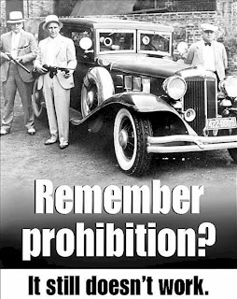

YAY OR NAY???

Slide 11
A Sneak Peek into the Jamaican Context

Slide 12
Jamaica currently has not implemented a ban on the use of social media by children/teens – whispers in the wind!
The child protection framework is one which is well-established:
UNCRC
(1991)
CCPA
(2004)
CHARTER OF FUNDAMENTAL RIGHTS & FREEDOMS
COMMISSION OF PARLIAMENT
(OCA – 2006)
INTER-MINISTERIAL WORKING GROUPS -> MDAs

Slide 13
National Online Child Protection Technical Committee
Appointed by the Executive Arm of the GOJ
Comprised of representatives from diverse sectors of the Jamaican society, including various MDAs
Mandate to develop a National Child Online Protection Policy and Strategy for Jamaica
Elements of development should include the review of institutional arrangements, evidence from research, examining emerging risks and comparative lessons as well as broad stakeholder consultations (including with children).
Process should result in the provision of a practical, rights-based and nationally owned policy and strategy for protecting and empowering children in digital environments (including social media).
Goal: a fully coordinated, child-centred and future-facing response to the range of online harms now affecting children

Slide 14
Jamaican Kids Online Study
Updated and most recent primary research on children’s digital lives. Built upon the OCA’s Be Social – Be Smart Safer Internet Usage Research that was done in 2016.
The JA Kids Online Study applied the Global Kids Online methodology to examine children’s internet use, online opportunities, risks, digital skills and help-seeking.
Evidence highlighted that Jamaican children are active participants in digital spaces - they used the internet for schoolwork, learning, entertainment, communication, social media and maintaining relationships.
Many children reported positive online experiences and saw the internet as a place with valuable opportunities.
Children also reported exposure to upsetting experiences, cyberbullying, sexual images, harmful user-generated content and difficulties linked to heavy internet use.
Gaps in digital literacy, help-seeking knowledge and use of reporting tools were also evident. Children may be confident users of digital platforms but still lacked the skills, information or trusted support needed to respond safely when something went wrong.

Slide 15


Proposed Position by Technical Stakeholders . . .
Jamaica’s framework should include –
Platform cooperation
Privacy and safety by design
Psychosocial support
Data collection
Child participation
Monitoring and periodic review as a mechanism through which to respond to both current and emerging digital risks.
NOT A SILVER BULLET

Slide 16
Views From Jamaican Children . . .

Slide 17
The Voices of Children
Key Finding from the Focus Group Discussion
The CAP members did not view social media as inherently harmful. Instead, they presented it as a tool with both significant benefits and significant risks.
Their preferred approach was therefore not simply to remove access, but to teach children how to use social media safely, strengthen parental supervision, improve platform safeguards, and involve children and young people in developing solutions. This perspective is evident throughout the discussion, particularly where participants contrast a total ban with restrictions and education.

Slide 18
Social Media is an Important Source of Information (schools, government organizations etc) and Learning
Children Believe a Complete Social Media Ban Is Unrealistic – can manipulate age verification/find alternative ways to access platforms.
Preference for Restrictions Rather Than an Absolute Ban
Parental Responsibility and Supervision Are Central to Online Safety
Parents Also Need Digital Literacy
Social Media Can Negatively Affect Mental and Emotional Well-being
Exposure to Harmful Content Is a Major Concern - children of tender years may require stronger safeguards/more monitoring.
Digital Safety Education Should Begin Early – incorporated into the primary school curriculum
How Information Is Delivered Matters – peer-to-peer, use teen voices to speak about online safety.
One-Off Awareness Campaigns Are Not Enough
Responsibility for Online Safety Should Be Shared – children, parents, school, church, community, tech companies.
Children Want to Be Treated as Capable Digital Users
Children Recognize Their Own Agency and Responsibility Online
A Ban = Breach of Rights - cited the right to access information from the media.

Slide 19

PARTICIPANTS’ QUESTIONS
1. Does a ban truly solve the problem?
2. Should governments do it anyway to show decisive action?
3. Are some rights less valuable than the need to protect?
4. Sacrifice and compromise rights for the greater good of children – what’s your take?

