Slide 1
Ending violence against children:
how the INSPIRE technical package can help
Melbourne, August 2026
Joana Madureira
WHO WPRO
Sabine Rakotomalala
WHO Headquarters
Bernie Madrid,
Philippines
Notes:
Good morning, everyone, and thank you to the Rise Up Policy Forum for having us. I'm Joana Madureira Lima , I’m the coordinator for Social Determinants of Health at WHO Regional Office for the Western Pacific. I’m joined today by Dr Bernadette Madrid, Director of the Child Protection Unit (CPU) of the University of the Philippines Manila, who will share what implementation looks like on the ground with the concrete example of the Philippines.
Over the next fifteen minutes, I want to give you an update on INSPIRE, walk through what the newest evidence tells us, and the priorities for its next phase. Many of you will be familiar with INSPIRE in your own practices in your respective countries but for those of you arent, INSPIRE is an evidence-based technical framework launched in 2016 by the World Health Organization (WHO), UNICEF, and global partners to help countries and communities end violence against children aged 0 to 17 years.
I mentioned that I work in this region but his is a global conference and INSPIRE is a global tool so let’s start with a bit of a global Birdseye view
Globally, up to one billion children — roughly every second child — experienced physical, sexual or psychological violence in the past year.

Slide 2
Question
In the past year, how many children around the world have experienced violence?
250 million
500 million
1 billion
2 billion

Slide 3
Question
In the past year, how many children around the world have experienced violence?
250 million
500 million
1 billion
2 billion
Notes:
Global prevalence of past-year violence against children: a systematic review and minimum estimates. Hillis S, Mercy J, Amobi A, Kress H. Pediatrics 2016; 137(3): e20154079.
Source: https://publications.aap.org/pediatrics/article-abstract/137/3/e20154079/81439/Global-Prevalence-of-Past-year-Violence-Against?redirectedFrom=fulltext

Slide 4
Violence against children
Globally up to 1 billion children have experienced physical, sexual or psychological violence in the past year.

Slide 5
Question
Which statement best illustrates the magnitude of violence against children?
Violence against children primarily affects adolescents
Most violence against children results in death
Violence affects tens of millions of children, with significant levels of physical and sexual violence
Violence against children affects boys and girls equally in all forms

Slide 6
Question
Which statement best illustrates the epidemiology of violence against children?
Violence against children primarily affects adolescents
Most violence against children results in death
Violence affects tens of millions of children, with significant levels of physical and sexual violence
Violence against children affects boys and girls equally in all forms

Slide 7

Magnitude of violence against children
Homicide is among the top five causes of death in adolescents.
80% of homicide victims are boys.
Beyond these deaths, tens of millions more children are affected by violence.
1 in 4 children suffer physical abuse.
Nearly 1 in 5 girls is sexually abused at least once in her life.
Notes:
To make that concrete: homicide is among the top five causes of death in adolescents, and 80% of homicide victims are boys.
Beyond those deaths, tens of millions more children are affected by violence that never appears in a mortality statistic — one in four children suffers physical abuse, and nearly one in five girls is sexually abused at least once in her life.
This is deliberately not only a health statistic. It shows up in homicide data, school data, justice data and economic data alike — which is exactly why this needs every sector in this room, not just health and welfare.

Slide 8
Question
Of the types of violence covered by INSPIRE, which are most common across all ages?
Child maltreatment
Bullying
Youth violence
Intimate partner/dating violence
Sexual violence
Emotional or psychological violence and the witnessing of violence

Slide 9
Question
Of the types of violence covered by INSPIRE, which are most common across all ages?
Child maltreatment
Bullying
Youth violence
Intimate partner/dating violence
Sexual violence
Emotional or psychological violence and the witnessing of violence

Slide 10
Types of violence against children
<5 years old
5-10 years old
11-17 years old
18+ years old
Notes:
The types of violence covered by INSPIRE are:
child maltreatment, most often at the hands of parents and caregivers;
bullying and youth violence which is typically between peers;
intimate partner violence (also known as dating violence);
sexual violence, and
emotional or psychological violence and the witnessing of violence.
While listed separately, each type of violence can co-occur with other types, and being a victim of one type of violence can increase the likelihood of involvement in other types of violence.
________________________________________________________
The types of violence covered by INSPIRE are:
•child maltreatment (including violent punishment)
- Includes:
- Physical, sexual and psychological/emotional violence
- Neglect of infants, children and adolescents by parents, caregivers and other authority figures
- most often at the hands of parents and caregivers, but also occurs in settings such as schools and orphanages.
•Bullying:
- Includes:
- Unwanted aggressive behaviour by another child or group of children (neither siblings nor in a romantic relationship with victim);
- Repeated physical, psychological or social harm
- Occurs in schools and other settings where children gather, and online
•Youth violence (among those 10-29 years)
- Includes:
- Physical assault with or without weapons, and may involve gang violence
- Occurs in community settings between acquaintances and strangers
•intimate partner violence:
- Involves:
- Violence by an intimate partner or ex-partner
- Disproportionately affects females
- Occurs:
- Commonly against girls in early and forced marriages
- Among romantically involved but unmarried adolescents (sometimes called “dating violence”)
•sexual violence
- Includes:
- non-consensual completed or attempted sexual contact;
- non-consensual acts of a sexual nature not involving contact (such as voyeurism or sexual harassment);
- acts of sexual trafficking committed against someone who is unable to consent or refuse;
- and online exploitation
•emotional or psychological violence and the witnessing of violence.
- Includes:
- restricting a child’s movements, denigration, ridicule, threats and intimidation, discrimination, rejection and other non-physical forms of hostile treatment.
- Witnessing violence can involve forcing a child to observe an act of violence, or the incidental witnessing of violence between two or more other persons.
* While listed separately, each type of violence can co-occur with other types, and being a victim of one type of violence can increase the likelihood of involvement in other types of violence.

Slide 11
Key areas for achieving collective impact
Clear logic model
Technical package
Monitoring
Partnerships
Communication
Political commitment
Notes:
Collective impact to deliver prevention of VAC at country scale doesn't happen by accident. The evidence points to six things that need to be in place together:
a clear logic model that links your activities to the outcome you actually want;
routine monitoring, so you know if it's working;
real partnerships;
deliberate communication; and
sustained political commitment that outlasts an election cycle.
a defined technical package — which is exactly what INSPIRE is, and what we're about to look at more closely;

Slide 12

The seven strategies
Notes:
INSPIRE is WHO's technical package of seven strategies for ending violence against children. INSPIRE is an acronym with each letter standing for one strategy.
I - Implementation and enforcement of laws,
N - Norms and values,
S - Safe environments,
P - Parent and caregiver support,
I - Income and economic strengthening,
R - Response and support services,
E- Education and life skills.
Nearly ten years since launch, INSPIRE is still the shared evidence base this Rise Up Forum forum works from. I won't walk through each strategy individually — Dr Madrid and I both assume most of you know this framework well. What I do want to show you is how these seven strategies actually function together, because that's where implementation tends to succeed or fail.

Slide 13
INSPIRE components
STRATEGIES
APPROACH
JUSTICE
JUSTICE
HEALTH
HEALTH
HEALTH
EDUCATION
EDUCATION
SECTOR
WELFARE
WELFARE
WELFARE
INTERIOR
PLANNING
FINANCE
LABOUR
CROSS-CUTTING ACTIVITIES
MULTISECTORAL ACTIONS AND COORDINATION
MONITORING AND EVALUATION
Notes:
Here's what that looks like in practice. Each of the seven strategies breaks down into three to five specific interventions, and — this is the part I'd draw your attention to — a set of sectors typically responsible for delivering them: justice, health, education, welfare, finance, planning, labour, and more, depending on the strategy
I -Implementation and enforcement of laws,
Banning violent punishment: Outlawing corporal punishment in homes, schools, and alternative care settings.
Criminalizing abuse and exploitation: Enforcing laws against sexual abuse, trafficking, and commercial exploitation.
Restricting access to weapons and alcohol: Limiting youth access to firearms/weapons and regulating alcohol availability and marketing
N - Norms and values,
Challenging harmful gender norms: Promoting gender equality and respectful relationships through community campaigns.
Community mobilization: Engaging community and religious leaders to shift social acceptance of violence.
Bystander intervention: Training peers and community members to safely intervene when violence or harassment occurs
S - Safe environments
Addressing “hotspots”
Interrupting the spread of violence
Improving the built environment -Improving the built environment: Upgrading public lighting, parks, and safe public transport routes.Reducing urban decay: Reclaiming abandoned properties and improving housing conditions
P - Parent and caregiver support,
Parenting programs: Offering evidence-based parenting skills training in community settings.
Home visiting services: Delivering targeted guidance and support to vulnerable new parents in their homes.
Comprehensive family support: Combining economic assistance with positive parenting education
I - Income and economic strengthening,
R - Response and support services,
E- Education and life skills.
.
No single ministry owns INSPIRE. Laws sit with justice and the interior; parenting support sits with health and welfare; education strategies sit with education. The two threads that hold it together are multisectoral coordination and monitoring and evaluation. If you take one structural point from this slide: a violence-prevention plan that lives inside a single ministry is, by design, only ever going to cover part of the package.

Slide 14
INSPIRE EVIDENCE UPDATE 2026!
Evolution of evidence and programmes
New data
on critical intersections
Emphasise
data from
low-resource settings
Address emerging issues in
the field
Notes:
So let's turn to what's new inside that technical package itself. It is now nearly a decade since INSPIRE launched, and the evidence base has moved. This update covers four things: the evolution of evidence and programmes, from newer evaluations and new modes of delivery; new data on critical intersections, particularly between violence against children and violence against women; a deliberate emphasis on data from low-resource settings, so the evidence reflects where most children actually live; and emerging issues the original 2016 package could not have anticipated — online spaces, technology-facilitated harm, and humanitarian settings.
This matters for this room specifically, because the original question INSPIRE answered was simply ‘what works?’. This update starts to answer a harder question: what works, for whom, and in what kind of setting.

Slide 15

EVIDENCE DISTRIBUTION BY STRATEGY
Implementation and enforcement of laws (7 reviews, 3%)
Norms and values (22 reviews, 10%)
Safe environments (16 reviews, 7%)
Parent and caregiver support (69 reviews, 32%)
Income and economic strengthening (15 reviews, 7%)
Response and support services (62 reviews, 29%)
Education and life skills (94 reviews, 44%)
Notes:
Here is the headline picture: how the evidence is actually distributed across the seven strategies, by number of reviews assessed.
Education and life skills has the deepest base — 94 reviews, 44% of everything we looked at. Parent and caregiver support follows at 69 reviews, 32%, then response and support services at 62 reviews, 29%. Norms and values sits at 22 reviews, 10%; safe environments at 16 reviews, 7%; income and economic strengthening at 15 reviews, 7%. Implementation and enforcement of laws has the smallest base, at 7 reviews, 3%.
I want to be careful about how you read this, because it's tempting to rank strategies by review count and treat that as a ranking of importance. An uneven distribution does not mean uneven strength of conclusions — a strategy with fewer reviews can still have very strong evidence behind a specific intervention within it. What the distribution does tell us: every one of the seven strategies has at least one intervention that meets our bar for prioritised implementation. There is no strategy you can afford to drop from a national plan for lack of evidence. The gaps that matter sit within strategies, between specific interventions, not across whole strategies.

Slide 16
SUMMARY OF MAIN FINDINGS
1
THERE IS A SIGNIFICANT AMOUNT OF RIGOROUS EVIDENCE AVAILABLE TO GUIDE POLICY AND PRACTICE.
2
THERE ARE EFFECTIVE INTERVENTIONS WITHIN EACH INSPIRE STRATEGY, WHICH IS CONSISTENT WITH THE 2016 FRAMEWORK.
3
ANALYSES IDENTIFIED INTERVENTIONS WITH CONSISTENT EFFECTIVENESS ACROSS CONTEXTS, WHICH SUPPORT RECOMMENDATIONS FOR PRIORITISATION.
Notes:
[8:58–10:43 · running total 10:43]
So what does this add up to? Three findings.
One: there is now a significant amount of rigorous evidence to guide policy and practice — this is no longer a field working on instinct.
Two: every INSPIRE strategy contains effective interventions, consistent with the original 2016 framework. Nothing in this update overturns the package; it strengthens it.
Three, and this is the one I think matters most for this room: the analysis identified interventions with consistent effectiveness across different contexts, which is what lets us recommend them for prioritisation with confidence.
I do want to flag an equity gap honestly. In high-income countries, 59% of intervention-outcome combinations were supported for prioritised implementation; in low- and middle-income countries, that figure is 39%. Seventeen combinations rated more highly in high-income settings, against seven rated more highly in low- and middle-income settings. That gap is itself a finding — a call to invest more evaluation effort exactly where most of the world's children live, and it's precisely the gap Dr Madrid's work speaks to directly.

Slide 17
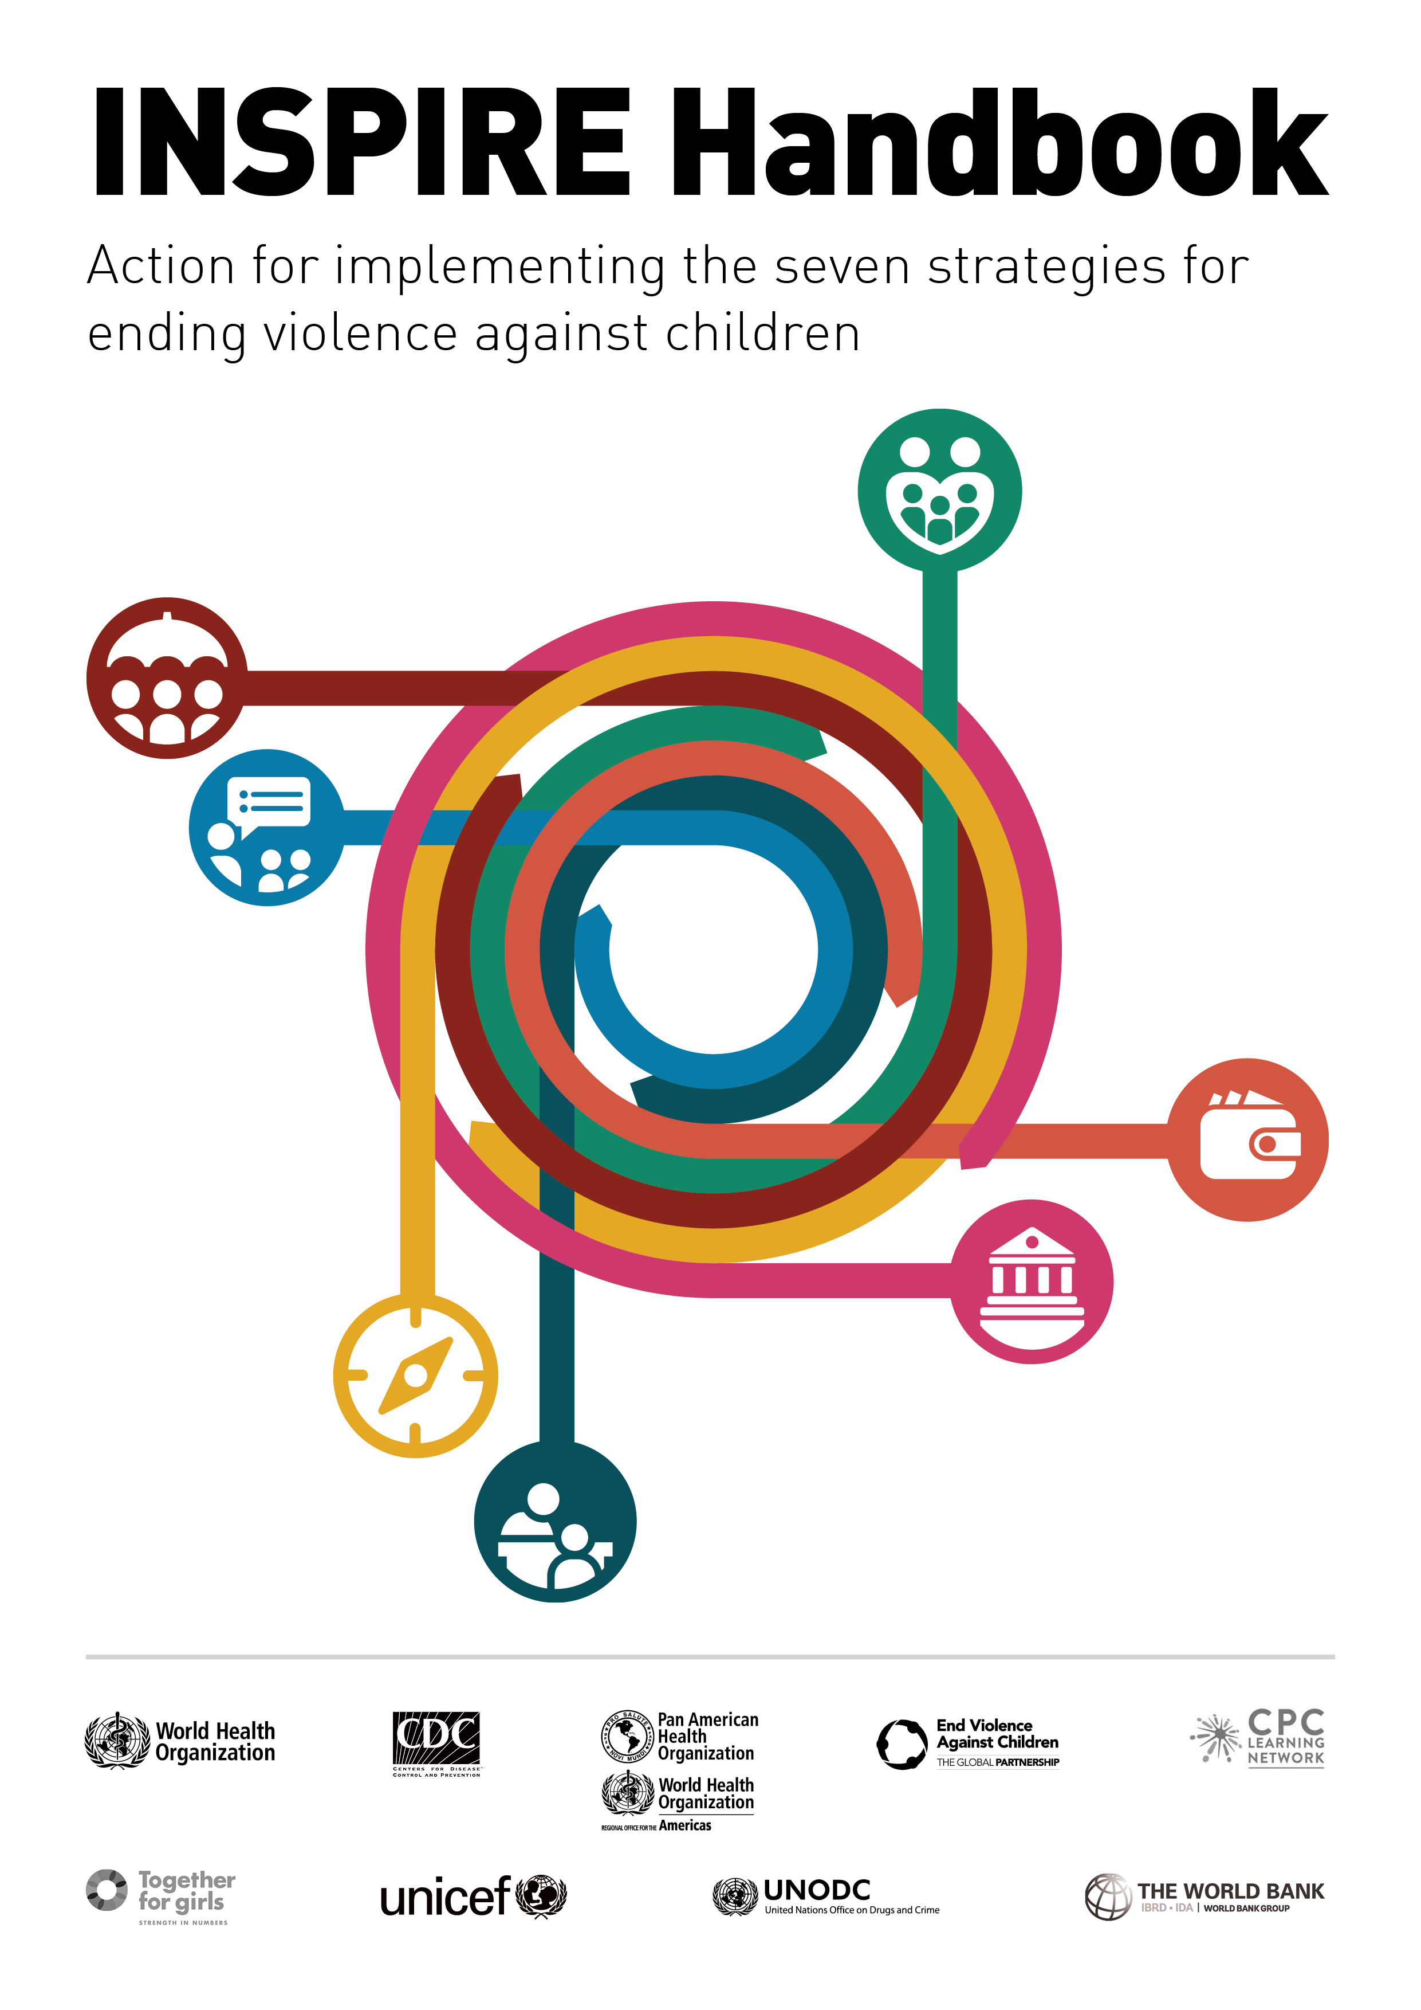
Technical package: Handbook
How to do it
Notes:
The core INSPIRE document sets out what we can do to prevent violence against children. The INSPIRE implementation handbook shown here provides detailed information on how to implement the package.
https://www.who.int/violence_injury_prevention/violence/inspire-package/inspire-handbook/en/

Slide 18
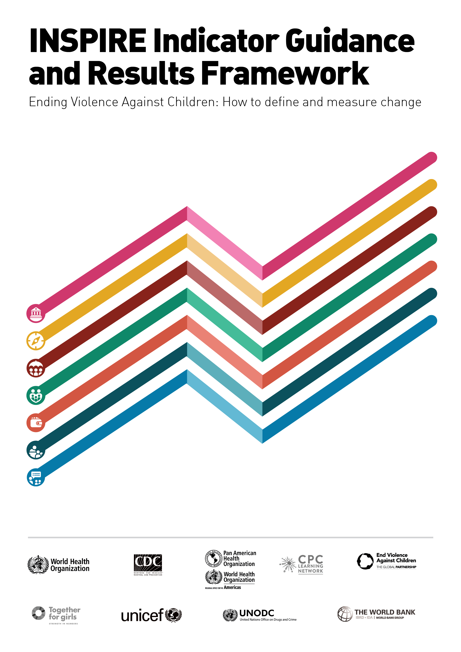
Technical package: Monitoring
How to measure impact
Notes:
The third and last component of the INSPIRE technical addresses the key area of monitoring. This is the indicator guidance and results framework document shown here.
https://www.who.int/violence_injury_prevention/violence/inspire-package/inspire-indicator/en/

Slide 19

Scale up
How to adapt and scale
Notes:
[10:43–12:29 · running total 12:29]
So — priority actions. This is really the question this forum is built around: not just what works, but how we get it to scale, responsibly.
Adaptation and scale-up are not new ideas to anyone in this room, but we still too often approach them without enough planning — expanding to new sites or sectors without anticipating shifts in resources, mandates or capacity, and without a long-term sustainability plan behind it.
WHO's scale-up guide exists to close that gap: it helps set goals appropriate to local conditions, set benchmarks so you know whether you are actually meeting them, and build in the conditions that let progress hold. In practice, for the next phase of INSPIRE that means stronger cross-sector coordination and accountability, sustained investment in the workforce delivering these programmes, and financing that outlasts a single project cycle. Success has to be measured by falling rates of violence, not just by activities delivered — not by how many workshops were run, but by whether children are actually safer at the end of it.

Slide 20
Partnerships for implementation
NGO‘s
Partnerships
Donors
Ending
VAC
Professional
associations
UN Agencies
Government
ministries
Academia
Notes:
[12:29–13:53 · running total 13:53]
None of this happens through any one actor alone. Going back to that list of six success factors I flagged earlier — partnerships is where all of this actually gets stitched together. Ending violence against children takes government ministries, UN agencies, donors, academia, professional associations and NGOs, coordinating around the same goal rather than working in parallel. That coordination is often the slowest part of this work — but it's the part that makes everything else durable.
I'll stop there, because Dr Madrid is going to take you into what this looks like when it's implemented in a low- or middle-income setting, where I think you'll see these priorities — coordination, workforce, financing, partnership — in a lot more practical, and sometimes more difficult, detail than I can capture in a summary.
Thank you, and over to Bernadette.

Slide 21
Thank you!
For more information:
http://www.who.int/violence_injury_prevention/violence/inspire/en/
www.who.int

