Slide 1

Addressing the Crisis of Youth ‘Aging Out’ of Care in Canada
Dr. Melanie Doucet
Executive Director & Project Lead

Slide 2
SESSION OUTLINE
INTRODUCTION WORDS FROM SENATOR KIM PATE
OVERVIEW OF THE CRISIS OF YOUTH ’AGING OUT’ OF CARE IN CANADA
OVERVIEW OF THE EQUITABLE STANDARDS FOR TRANSITIONS TO ADULTHOOD FOR YOUTH IN CARE IN CANADA
OVERVIEW OF THE SENATE OF CANADA REPORT - NOTHING TO CELEBRATE: THE CRISIS OF YOUTH AGING OUT OF CARE
GOVERNMENT OF CANADA RESPONSE TO SENATE RECOMMENDATIONS
NEXT STEPS – BUILDING EVIDENCE FOR CANADA-WIDE IMPLEMENTATION

Slide 3

Notes:
Senator Kim Pate words of introduction

Slide 4
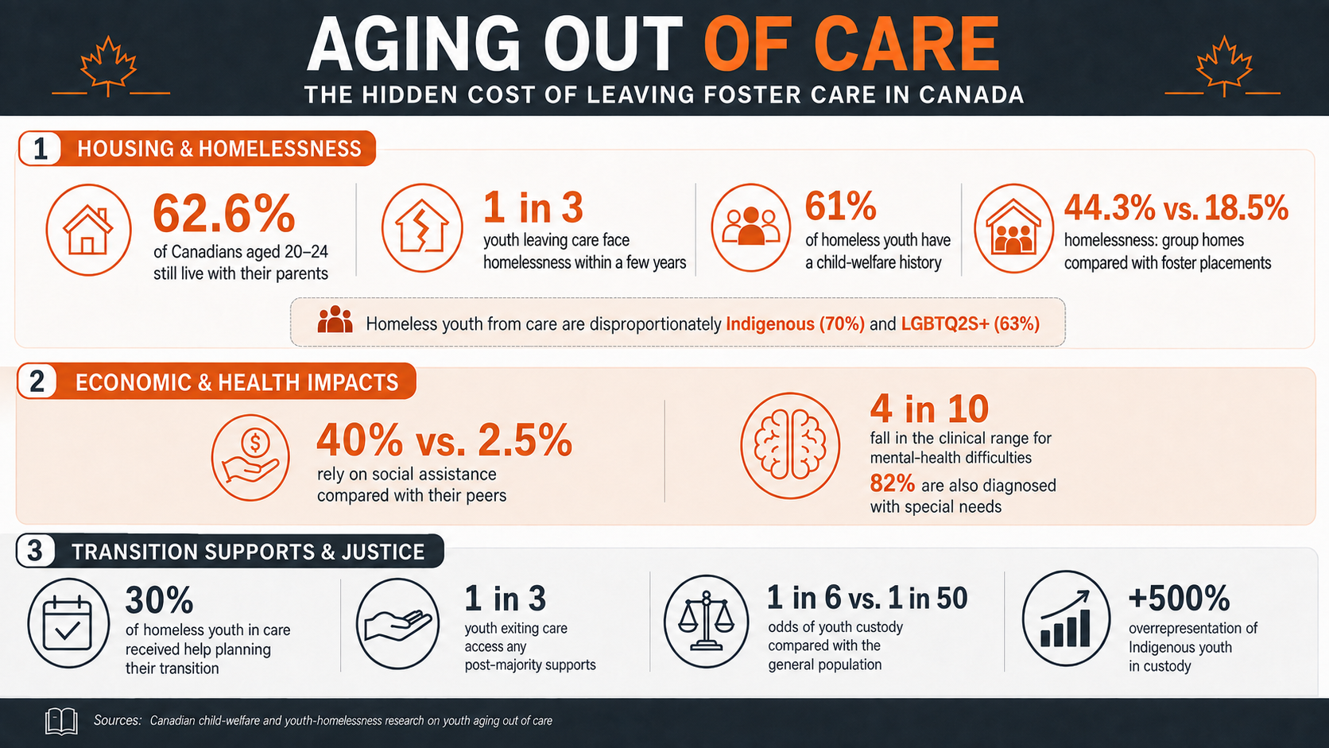

Slide 5
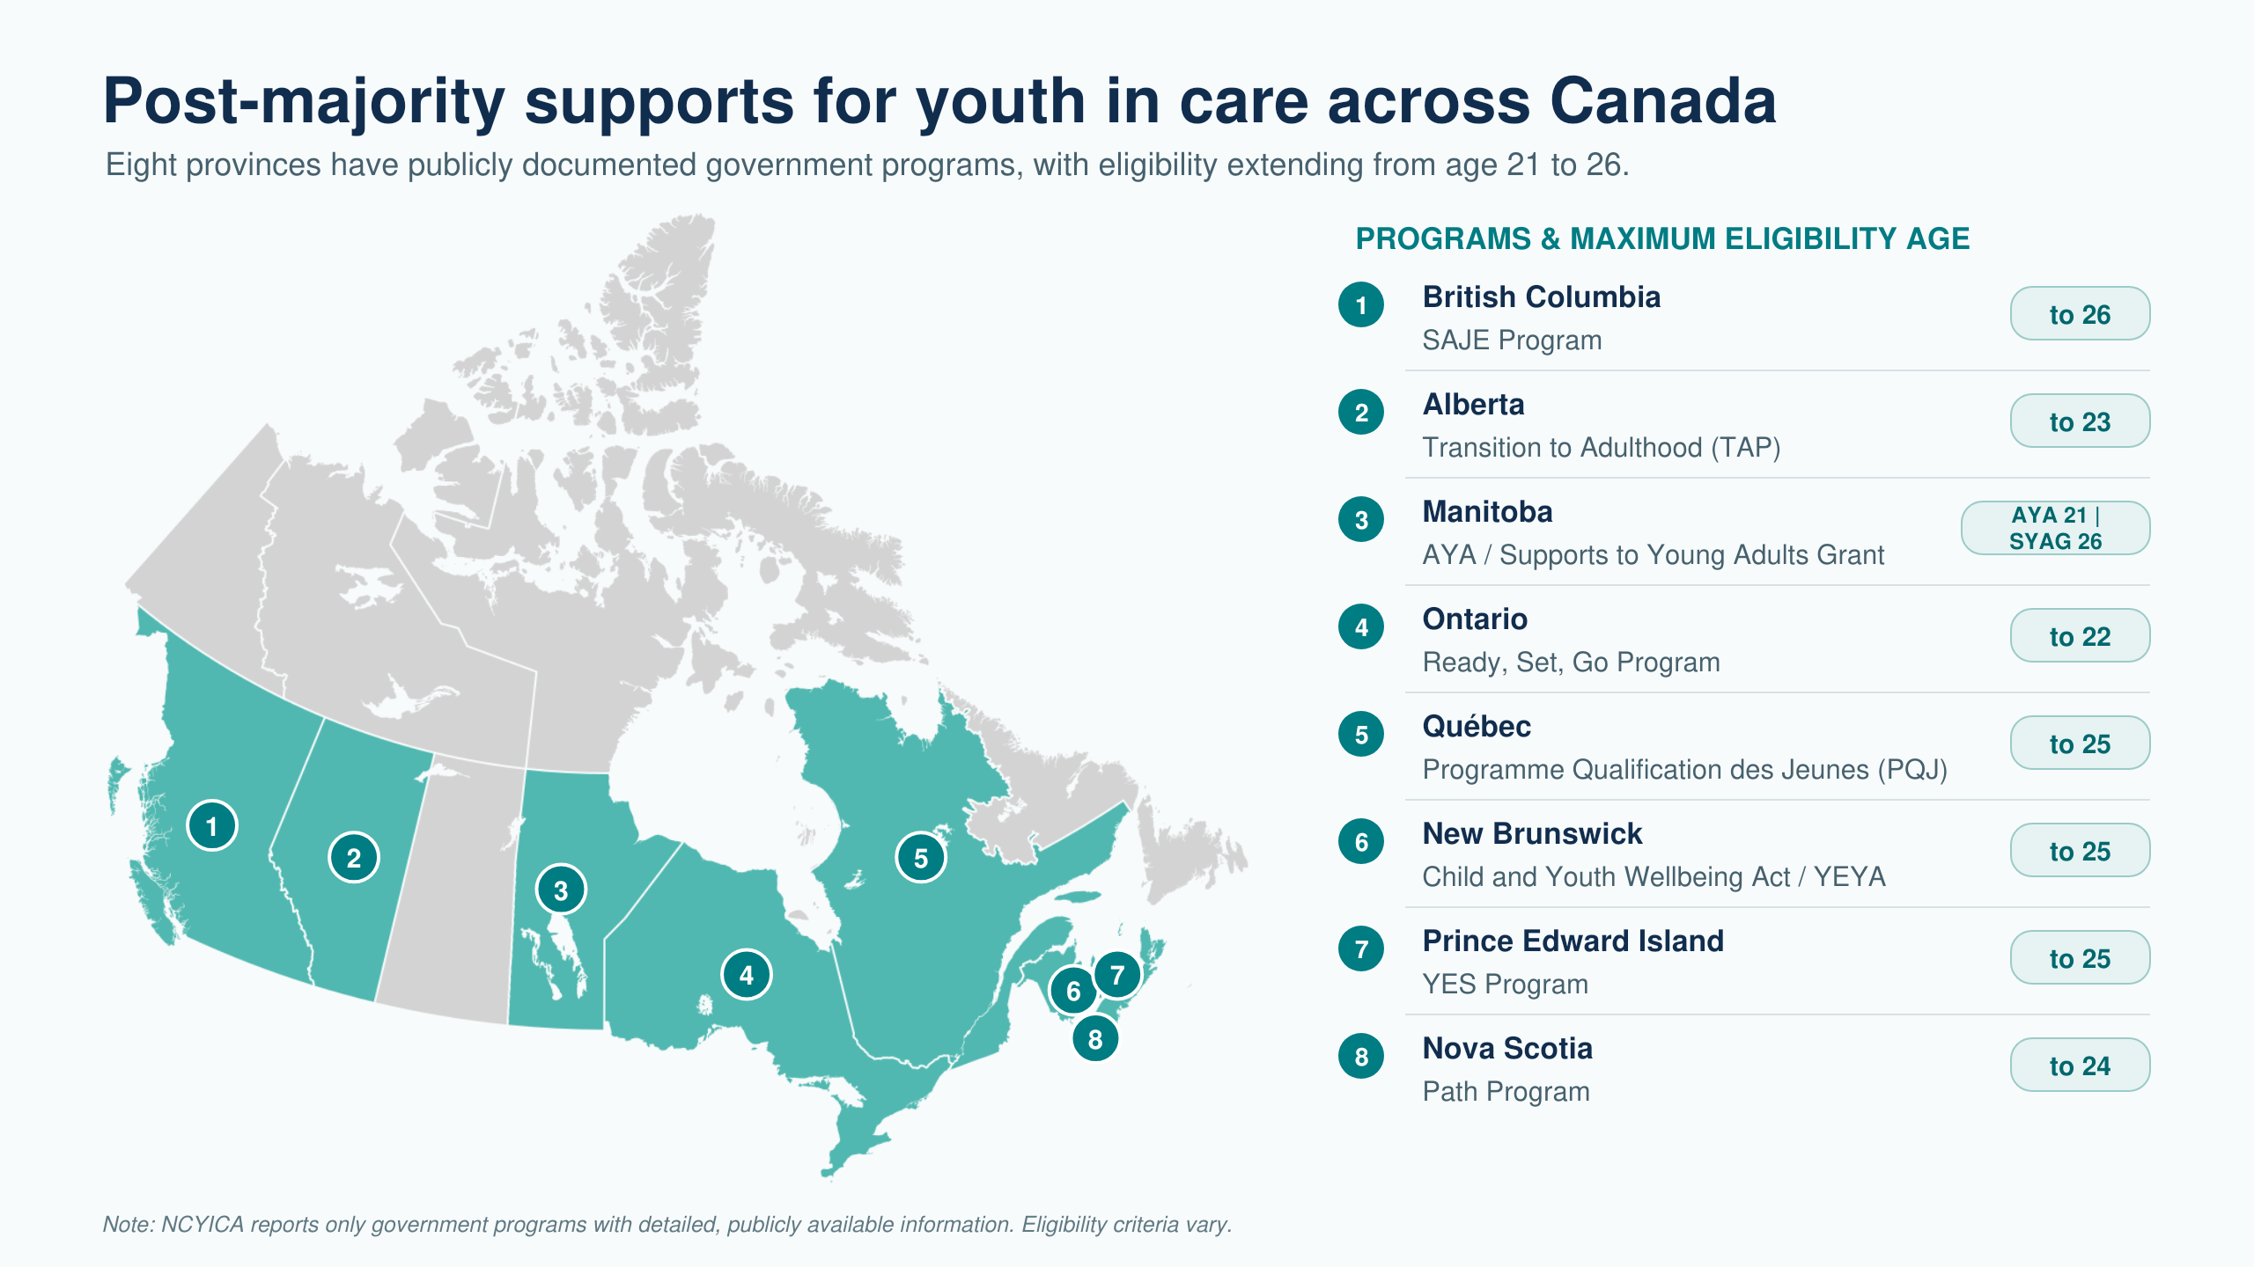

Slide 6

Slido question #1
At what age do most formal leaving care supports end in your jurisdiction?
Notes:
Before age 18
At age 18
At age 19
Ages 20–21
Ages 22–25
After age 25
No consistent age—it depends on eligibility or circumstances
Unsure

Slide 7
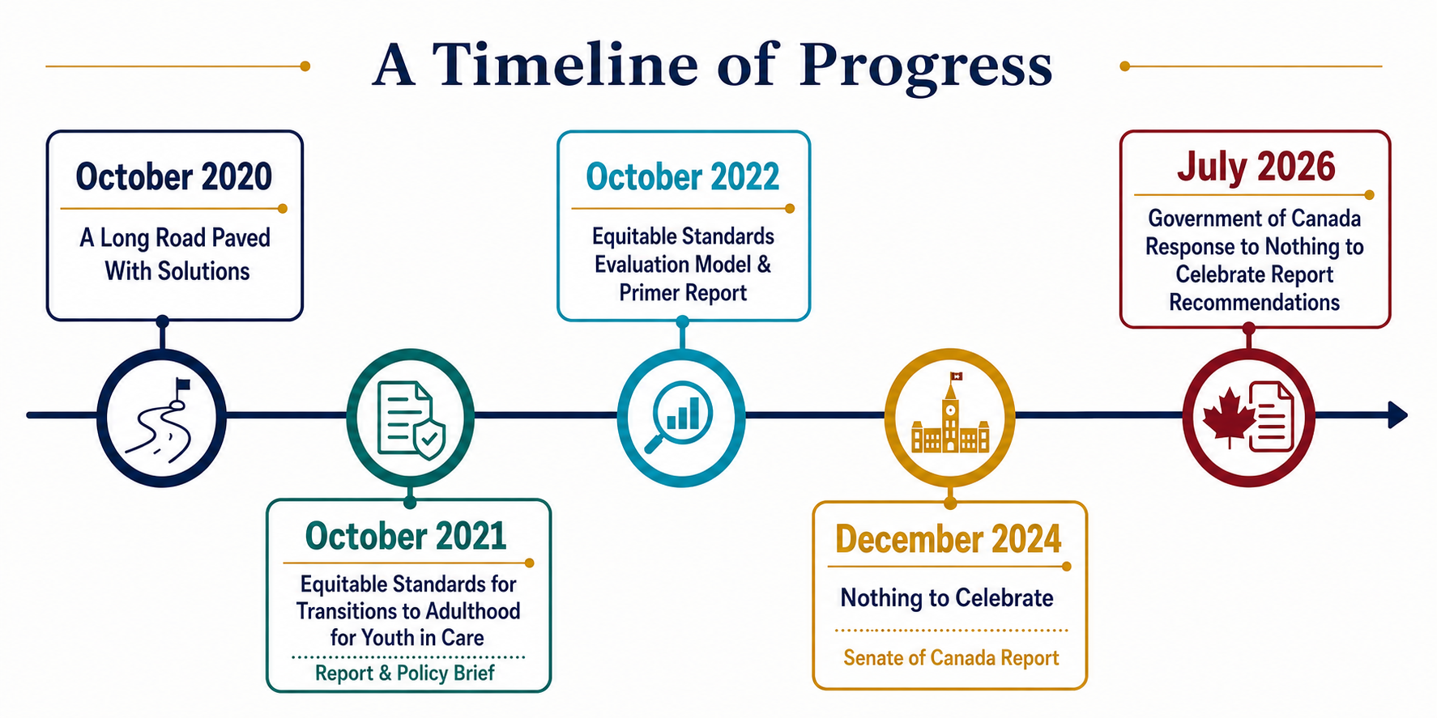

Slide 8
Slido question #2
Which areas presents the greatest gap for young people transitioning from care in your jurisdiction?
Notes:
Select up to 2 of the following:
Financial security
Education and professional development
Housing
Relationships and belonging
Culture and spirituality
Health and well-being
Advocacy and rights
Developmental support through emerging adulthood

Slide 9
The 8 Transition to Adulthood Pillars

Slide 10
THE EQUITABLE STANDARDS EVALUATION MODEL
Financial
Educational & Professional Development
Housing
Relationships
Every young person should have the financial resources required to meet their needs. Youth in care deserve to have a financial starting point that is above the poverty line, and allows them to pursue their career interests and dreams.
Every young person should experience an environment where they can learn and grow in ways that are meaningful to them and at their own pace.
Every young person should have a place they can call home, without strict rules and conditions to abide by.
Every young person should have people in their life that they can count on unconditionally and interdependently. Youth in care need to feel that they belong, have worth and are valuable members of their communities.
Culture & Spirituality
Health & Wellbeing
Advocacy & Rights
Emerging Adulthood Development
Every young person should be connected to their culture and spirituality, in ways that are meaningful to them, safe, and at their own pace.
Every young person should be provided with timely ongoing services and benefits that support their lifelong health and well-being. These supports need to be offered within a trauma-informed, non-judgemental harm reduction approach, without significant wait times.
Every young person should have their rights respected and should experience environments where their voices are heard, and their silence is addressed holistically.
Every young person should experience environments that cultivate personal growth and development as they transition into adulthood.
Notes:
Released in Fall 2022
Developed the Evaluation Model based on each of the 8 Transition to Adulthood Pillars and associated Equitable Standard – 8 modules to complete
An accountability and quality assurance tool for stakeholders to assess their fidelity to each of the eight Equitable Standards and associated key supports, and to determine areas that require further
work.
The key supports listed under each pillar are a starting point to establish minimum guaranteed supports & services that need to be in place before a young person fully transitions to adulthood – a minimum threshold that has been non-existent to date.

Slide 11
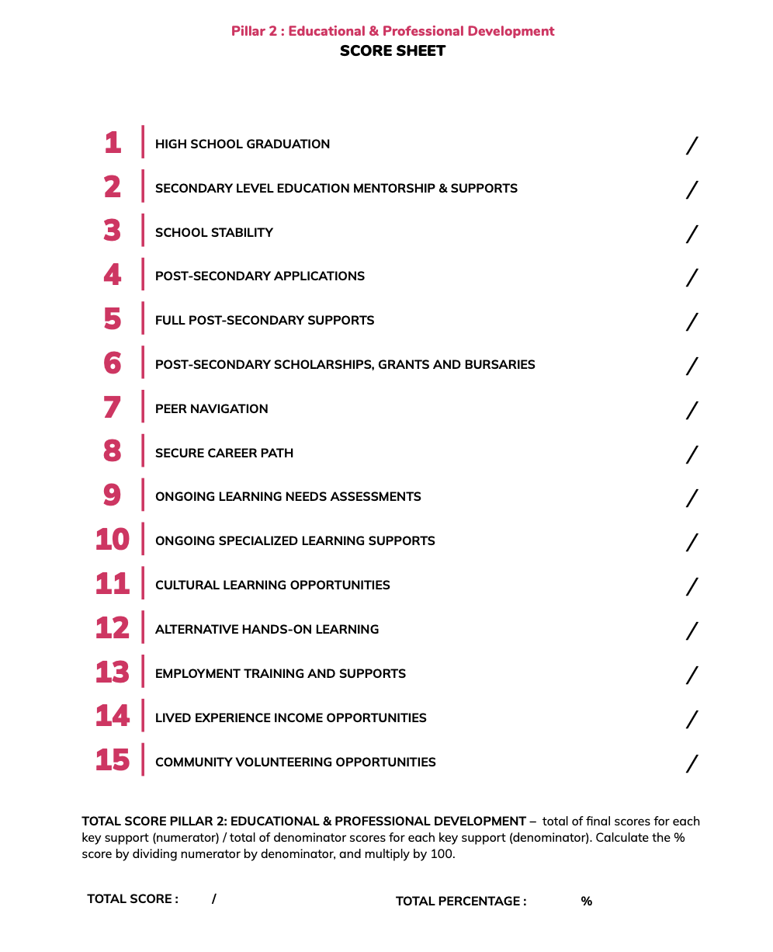
Notes:
Example of a scoring sheet for the module for Pillar 2

Slide 12
Notes:
The Equitable Standards Evaluation Model has been developed taking into account the need for collaboration and integration of supports and services for youth in and from care.
Focus on the shared responsibility of positive youth in care outcomes, across all key stakeholders and sectors
Those who hold responsibility for the implementation/provision of a particular key support complete elements A & B
Those who do not are still held accountable via the advocacy element (C)

Slide 13
The Equitable Standards Evaluation Model
1
ORANGE – minimal level
3
BLUE – strong level
2
YELLOW – moderate level
4
GREEN – exceptional level
Notes:
The fidelity scale provides a step-by-step approach to achieving Full Equitable Support (4)
A score of 0 should be applied when nothing is in place, there is no collaboration, and there are no advocacy efforts in place for the particular key support.
We don't expect anyone to achieve perfect (or even close to perfect) scores - this is a starting point (baseline assessment), with a plan to move further up the scale and meet the equitable standards through concrete actions over the next 1 to 5 years.

Slide 14
6 steps to complete the Equitable Standards Evaluation Process (Pilot)
STEP 1
STEP 2
STEP 3*
Undertake a baseline assessment of fidelity to the Equitable Standards using the Evaluation Model, which was formulated based on the list of key supports required under each of the eight Transition to Adulthood Pillar.
Calculate the fidelity score for each key support + percentage score for each Transition to Adulthood Pillar, and identify key areas for improvement.
Develop a concrete action plan*, with Steering Committee input, based on the outcome of the assessment: short-term (key supports that can be implemented within 1 year), medium-term (can be implemented within 2 years) and long-term (can be implemented within 5 years).
STEP 4
STEP 5*
STEP 6
Publicly release the Equitable Standards Action Plan to showcase transparency and accountability to the youth in care community.
Establish an Equitable Standards Steering Committee, with diverse youth in/from care representation*, to regularly review the implementation progress of the Equitable Standards Action Plan.
Re-do the Evaluation Process & publish an Equitable Standards Action Plan Progress Update Report every 5 years to ensure ongoing transparency, accountability, progress and commitment of fidelity to the Equitable Standards (post-pilot phase).
Notes:
For the pilot phase we expect steps 1-5 to be completed, but we would hope that key stakeholders will see the value in this exercise and continue doing quality assurance assessments via the Evaluation model on a regular basis (every 5 years) as this is an ongoing commitment – some key supports will take years to implement
Steering Committee should be established by Step 3 at the latest, to collaboratively develop the action plan, and then continue meeting for Step 5

Slide 15
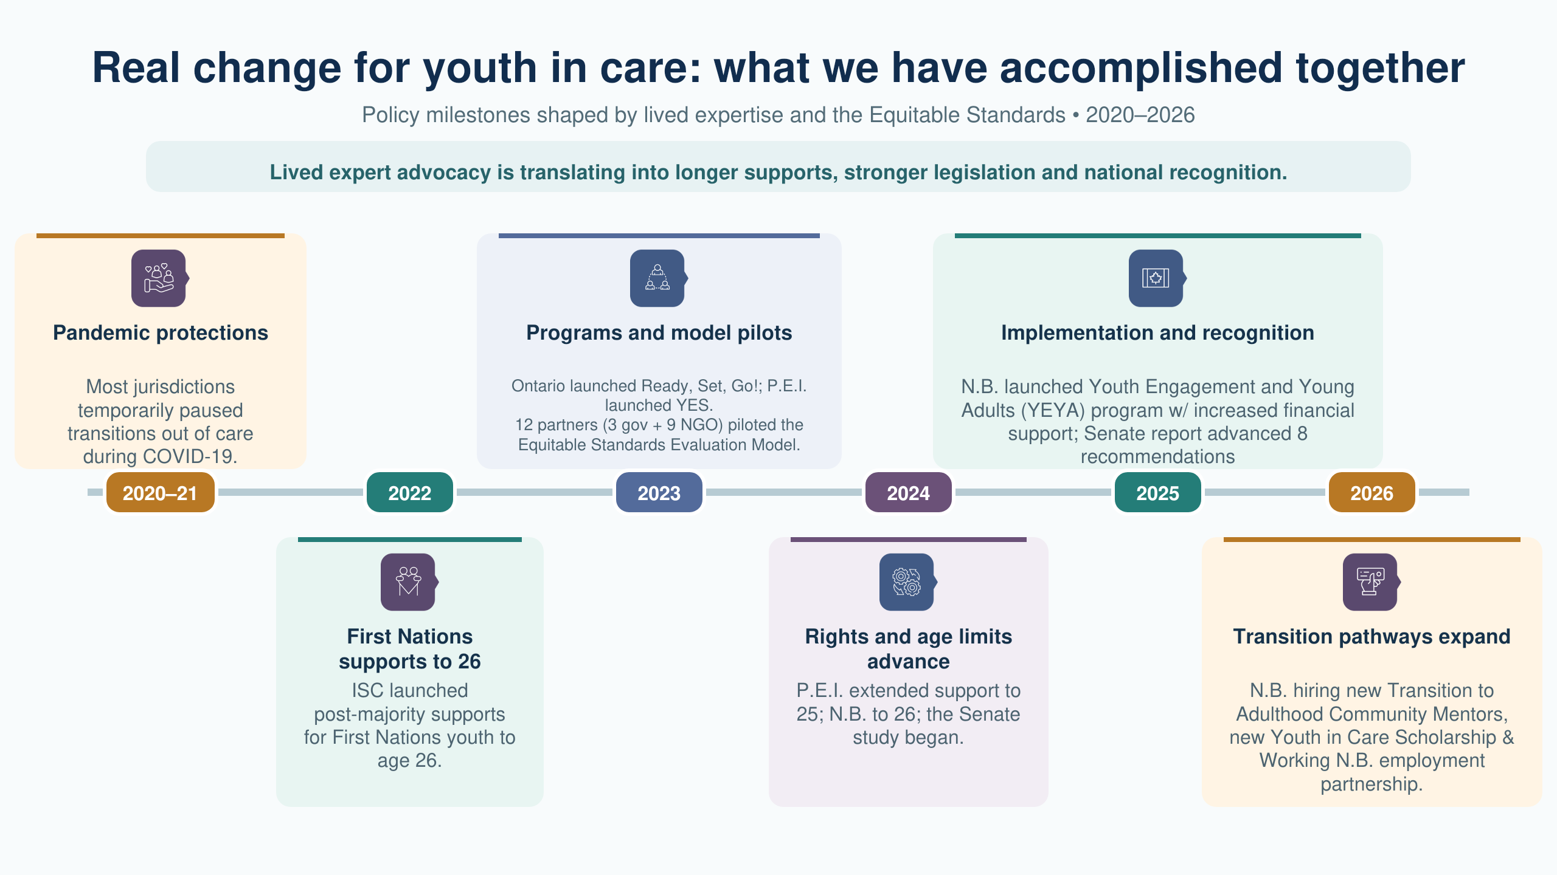

Slide 16

SENATE REPORT | DECEMBER 2025
8 recommendations
for meaningful systemic change
A national call to replace abrupt age cut-offs with coordinated, holistic and equitable supports into adulthood.
Notes:
- Senate of Canada, Nothing to Celebrate: The Crisis of Youth Aging Out of Care (December 2025) https://sencanada.ca/content/sen/committee/451/RIDR/Reports/AgingoutofCare_final_e.pdf

Slide 17
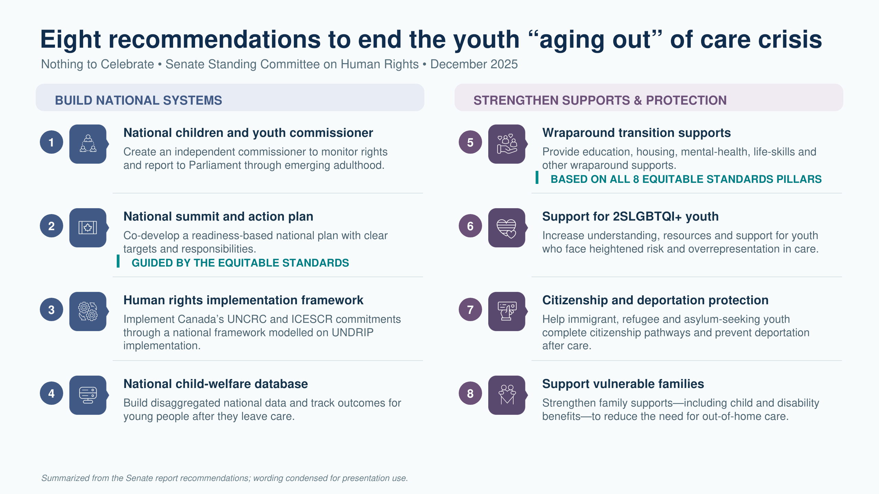

Slide 18
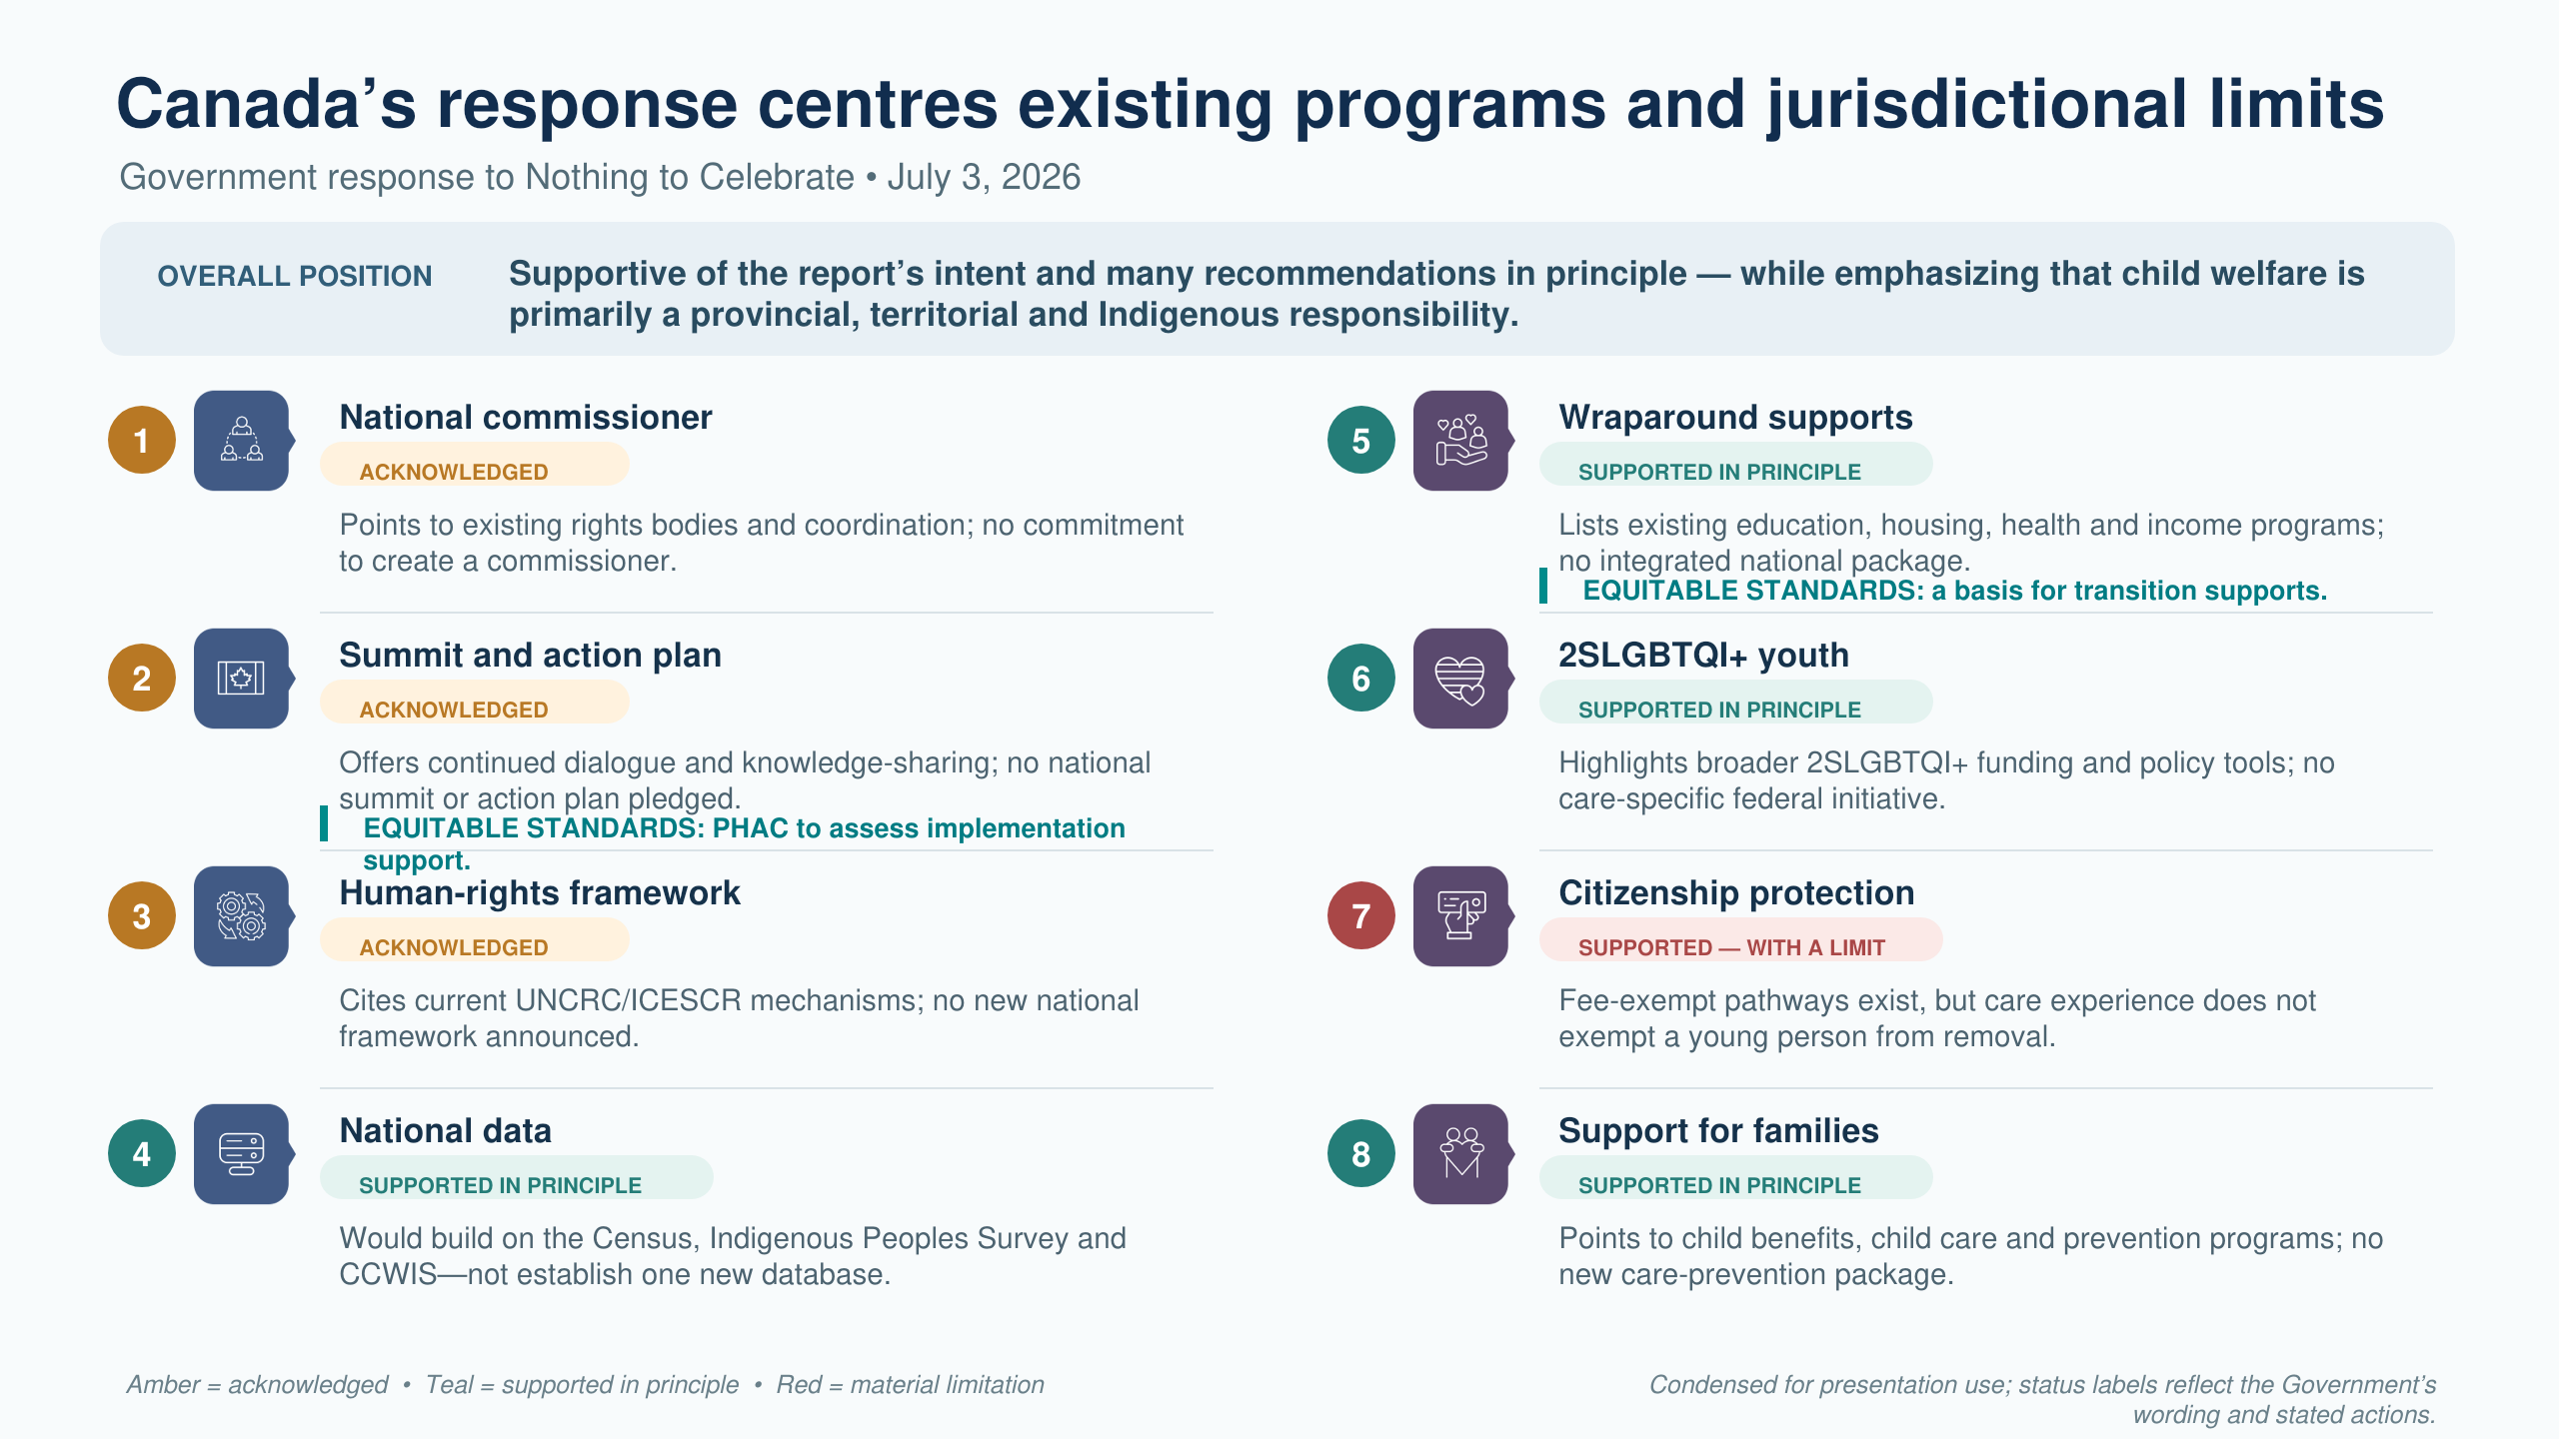

Slide 19
Slido question #3
What is the greatest barrier to improving transitions from care in your jurisdiction?
Notes:
Political will or competing priorities
Fragmented government responsibilities
Inadequate or short-term funding
Age-based legislation or eligibility rules
Gaps between policy and implementation
Limited data and accountability
Insufficient power-sharing with care-experienced young people
Workforce or service capacity
Other (please specify)

Slide 20
EQUITABLE STANDARDS • FIVE-YEAR ROADMAP
From evaluation to lasting implementation
Federal funding supports impact evaluation of the Equitable Standards, 2026–2031
Fall 2026 & Winter 2027
SPRING 2027
2027–30
2027–31
2030
BUILD
LAUNCH
LEARN
SCALE
SHARE
Finalize and digitize the Equitable Standards Evaluation Model
Online evaluation platform & National Call to Action Campaign
10–12 early adopters + 10–12 new adopters
3 waves quantitative + qualitative data
Commitment of 2–3 government jurisdictions + up to 40 NGOs
Host the Equitable Standards Symposium with research partners
↻
COMMUNITY OF PRACTICE
2023 → ONGOING
Ongoing peer learning, implementation support and shared accountability

Slide 21
Closing reflection:
What is one idea I will carry forward?
Who will I share it with?
How will care experienced people share power in determining what happens next?
Notes:
Closing reflection
When I return to my jurisdiction:
What is one idea from today that I will carry forward?
Who will I share it with?
How will care-experienced young people share power in determining what happens next?

Slide 22

Equitable Standards Resources https://linktr.ee/standwithyouthincare

Slide 23






MORE ABOUT SENATOR PATE’S WORK
↗ Tona’s Law
(Solitary Confinement)
↗ Guaranteed Livable Income
↗ Record Expiry
↗ Fair Sentencing
↗ 12 Indigenous Women Report
↗ Prison Law Booklets
Website • senpate.sencanada.ca
Senate Bio • sencanada.ca/senators

Slide 24
Questions?
Comments?
Dr. Melanie Doucet
Executive Director & Project Lead
melanie.doucet@gmail.com

Slide 25
Small group discussion
Notes:
If there is time – small groups of max 5 or 6 tables
15 minutes

Slide 26
1. What element of your system—or what structural barrier—most needs to change to ensure continuity of support throughout emerging adulthood?
2. What is one promising policy or practice from your jurisdiction that advances one or more of the Equitable Standards pillars and that others could learn from? What conditions, partnerships or advocacy made it possible?
Notes:
The Equitable Standards were developed in Canada, but the needs and rights they address are not uniquely Canadian. The Standards identify eight interconnected areas through which we can examine whether young people transitioning from care have the resources, relationships, opportunities and support they need to thrive throughout emerging adulthood.
I invite you to use the Equitable Standards today as a flexible diagnostic and discussion framework—not as a model to be transplanted unchanged, but as a set of principles that can be interpreted and adapted within your own legal, political, cultural and community context.
As you discuss and share experiences from your jurisdictions, consider both what young people leaving care should be able to count on universally and what must be adapted to reflect local contexts, cultures and systems.

Slide 27
Report back:
One shared structural challenge
One transferable policy or practice
Notes:
7 minutes:
one shared structural challenge
one transferable policy or practice

Slide 28
Sources
(1) Statistics Canada. (2016). Census in brief: Young adults living with their parents in Canada in 2016 [Catalogue: 90-200-X].
(2) Doucet, M., Al-aibi, T., Dzhenganin, M., Emmanuel, K., Jules, R., Merrill-Parkin, R., Pratt, H., Read, J., & Vanderwal, S. (2018). Relationships Matter for Youth 'Aging Out' of Care Research Report. Victoria, BC: BC Representative for Children and Youth.
(3) Gaetz, S., O’Grady, B., Kidd, S., & Schwan, K. (2016). Without a Home: The National Youth Homelessness Survey. Toronto: Canadian Observatory on Homelessness Press.
Bonakdar, A., Gaetz, S., Banchani, E., Schwan, K., Kidd, S.A., & O’Grady, B. (2023). Child protection services and youth experiencing homelessness: Findings of the 2019 national youth homelessness survey in Canada. Children and Youth Services Review, 153, 107088. https://doi.org/10.1016/j. childyouth.2023.107088
(4) Goyette, M., Blanchet, A., Bellot, C., Boisvert-Viens, J., & Fontaine, A. (2022). Homelessness, judicialization and marginalization of ex-placed youth in Quebec. Chaire de recherche sur l’évaluation des actions publiques à l’égard des jeunes et des populations vulnérables (CREVAJ).
(5) Rutman, D., Hubberstey, C., Feduniw, A., & Brown, E. (2007). When youth age out of care – where to from there? Final report based on a three-year longitudinal study. Victoria, BC: University of Victoria.

Slide 29
Sources
(6) Beaupré, J. & Flynn. R.J. (2014). Eastern Ontario Longitudinal Study of Crown Ward Transitions, Year 1 Report (2012-2013): Young People’s Status at the Point of Transition. Ottawa, ON: Centre for Research on Educational and Community Services, University of Ottawa.
Ontario Association of Children’s Aid Societies (OACAS, 2011). Children’s well-being: The Ontarian perspective. Child welfare report 2011. Toronto: OACAS.
(7) Beaupré, J. & Flynn. R.J. (2014). Eastern Ontario Longitudinal Study of Crown Ward Transitions, Year 1 Report (2012-2013): Young People’s Status at the Point of Transition. Ottawa, ON: Centre for Research on Educational and Community Services, University of Ottawa.
Tessier, N.G., Flynn, R.J., & Beaupré, J. (2014). A pilot 12-month follow-up study of Crown Ward transitions: Comparison with young people in the general population. Unpublished manuscript. University of Ottawa.
(8) Bonakdar, A., Gaetz, S., Banchani, E., Schwan, K., Kidd, S.A., & O’Grady, B. (2023). Child protection services and youth experiencing homelessness: Findings of the 2019 national youth homelessness survey in Canada. Children and Youth Services Review, 153, 107088. https://doi.org/10.1016/j. childyouth.2023.107088
(9) Hyslop, K. (2017). Ministry Says Supports ‘Available’ to Youth Exiting Province’s Care. How Available? Vancouver, BC: The Tyee.

Slide 30
Sources
(10) BC Representative for Children & Youth (2009, February 23). Kids, Crime and Care. Health & Well-Being of Children in Care: Youth Justice Experiences & Outcomes.
(11) The John Howard Society of Canada (2017, October 19). Race, Crime and Justice in Canada.
(12) Doucet, M. & National Council of Youth in Care Advocates (2020, October 20). A Long Road Paved with Solutions: 'Aging out' of care reports in Canada. Key recommendations and timelines (1987-2020). Ottawa, ON: CWLC.
(13) Doucet, M. & National Council of Youth in Care Advocates (2021, October 4). Equitable Standards for Transitions to Adulthood for Youth in Care. Ottawa, ON: CWLC.
(14) Doucet, M. & National Council of Youth in Care Advocates (2022, October 20). Equitable Standards for Transitions to Adulthood for Youth in Care Evaluation Model: Primer Report. Ottawa, ON: Child Welfare League of Canada (CWLC).

Slide 31
Sources
(15) Standing Senate Committee on Human Rights (2025, December). Nothing to Celebrate: The crisis of youth aging out of care. Ottawa, ON: Senate of Canada.
(16) Government of Canada (2026, July). Response to the Standing Senate Committee on Human Rights’ first report entitled Nothing to Celebrate: The Crisis of Youth Aging Out of Care. Ottawa, ON: Government of Canada.

