Slide 1


FROM SILOS TO A SYSTEM – KENYA'S CROSS-SECTOR COORDINATION AND COLLABORATION MODEL
ISPCAN Rise-Up Forum - Melbourne August 2026
Dr Moses Maranga, National Council on the Administration of Justice in Kenya and Dr Claire Cody, Terre des Hommes Netherlands

Slide 2
Aims
To demonstrate how a systems approach can lead to better results as compared to a siloed approach in enhancing access to justice for children
To discuss other good practices in systems approaches to child protection
To critically reflect on what makes these systems approaches work and the different barriers and challenges experienced
To identify key lessons from those in the room around how to move from a silos to systems approach in diverse contexts

Slide 3
Why system coordination matters in addressing siloed challenges
Children should experience one justice journey, not separate institutional mandates
Fragmented pathways
Referral leakage
Uneven access
Data gaps
Unclear handovers weaken protection, and evidence quality
Weak data and information sharing limits prevention and accountability.
Varied local approaches and practices yields uneven access
Separate entry points for reporting, investigation, prosecution, court, protection and aftercare.
Focus of the Presentation – Demonstration that a Systems Approach yields better results than a Siloed Approach in enhancing access to justice for children

Slide 4
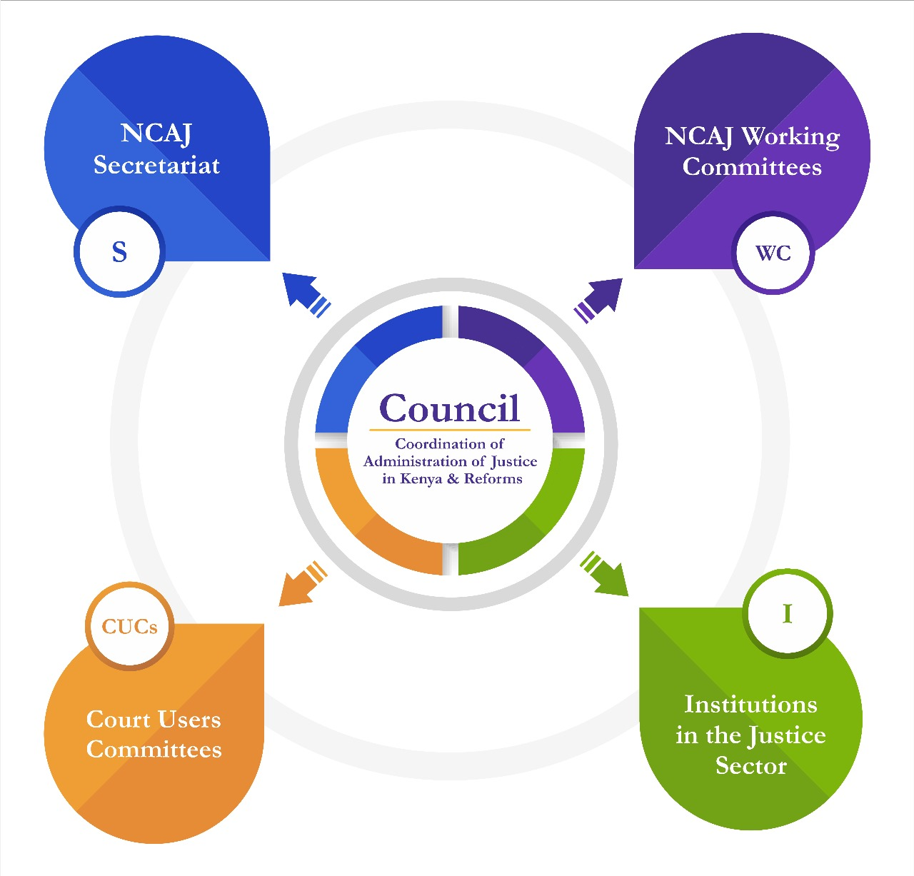
National Council on the Administration of Justice (NCAJ) –
Established under the law to ensure a coordinated, efficient, effective administration of justice, and reforms of the justice system – comprises 46 Agencies
From Siloed Approach to a Whole-of-justice Ecosystem

Slide 5
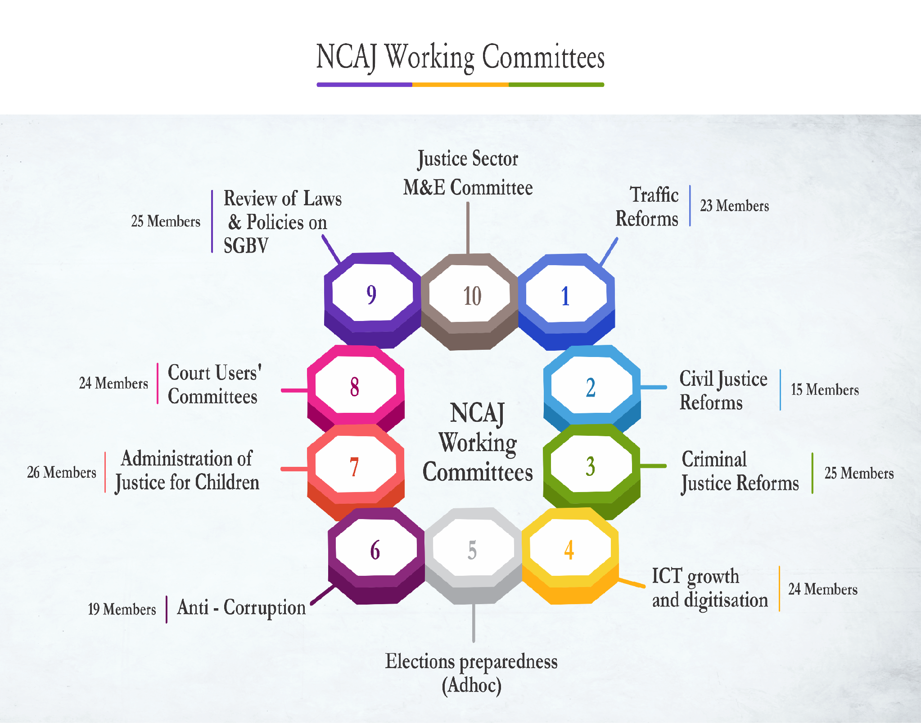
Working Committee is on the Administration and access to justice for children – Has 20 Agencies that handle Children

Slide 6


From Siloed Strategy Development to a Sectoral Strategy on Justice for Children. The Strategy acts as State/Non State agencies Contribution Map
From Siloed Reporting of Progress on Access to Justice for children, to Justice-Sector reporting

Slide 7
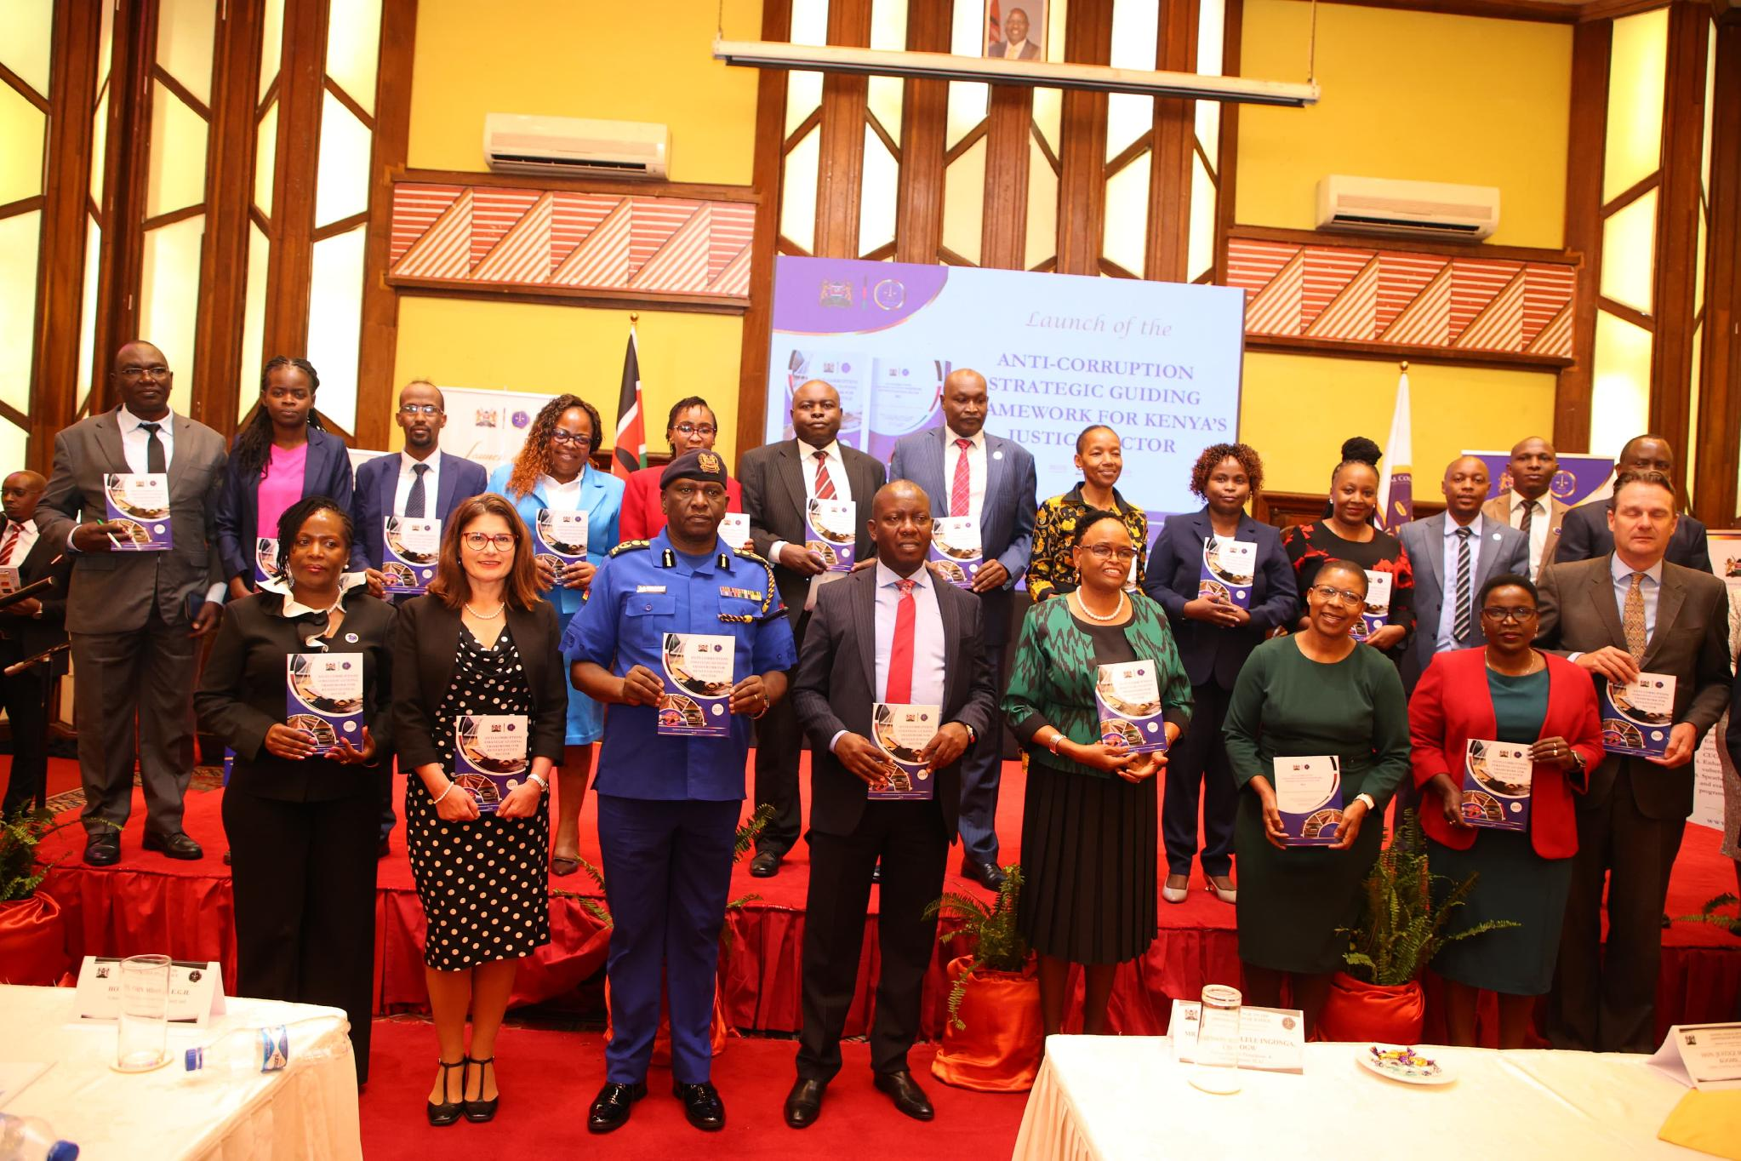
From Siloed Reporting to a System Reporting

Slide 8
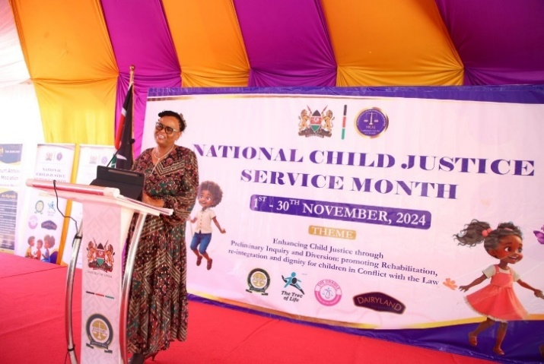
From Siloed approach in addressing case backlog for children to multi-Institutional Approach in clearing backlog cases during Service Month held every Year

Slide 9

Addressing challenges faced by the justice system through Multi-institutional Procedures

Slide 10

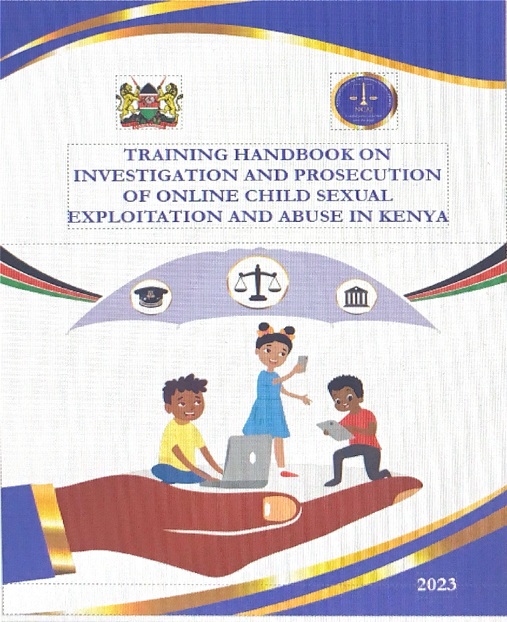
From Siloed Training on OCSE & Budgeting for Children to System’s based Training and Budgeting

Slide 11
Challenges Experienced in Moving from a Siloed Approach to a Systems-Based Child Justice System
Frequent transfers of government officers, which disrupt service continuity, weaken relationships, affect coordination and implementation of interventions.
The rapidly evolving nature of digital threats, including OCSE, which requires continuous analysis, training, digitisation and adaptation of response mechanisms.
Inadequate funding for systems-based reforms and inter-agency coordination, limiting the implementation and scaling of joint child justice initiatives.
Restrictive defined institutional mandates, which constrain information sharing, joint planning, resource pooling, and coordinated responses across agencies.

Slide 12
Key Outcomes/Results of a Systems Approach
Strengthened collaboration and coordination between government and non-state actors in preventing and responding to OCSE and other forms of violence.
More efficient utilisation of human and financial resources through joint planning, information sharing and reduction of duplication of efforts.
Greater adoption of child-friendly and trauma-informed justice services, resulting in more sensitive handling of children throughout the justice process.
Improved efficiency and effectiveness of the child justice system through better case management, quick case resolution and stronger institutional accountability.
More sustainable justice-sector responses, with agencies working towards shared priorities and outcomes rather than operating through isolated interventions.

Slide 13
Case study
Improving coordination and collaboration in the justice sector:
Addressing online child sexual exploitation (OCSE) in Nairobi

Slide 14
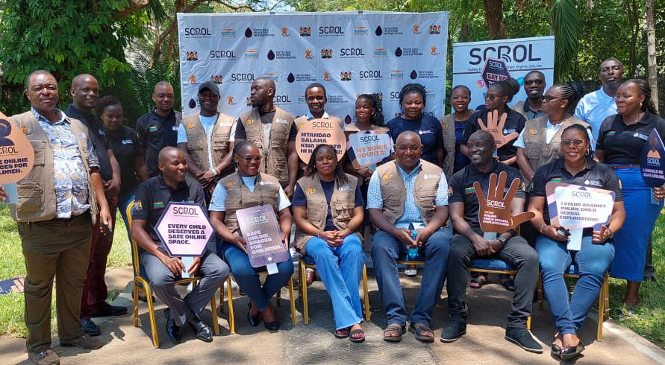
TdH NL’s Contribution to improving coordination to online child sexual exploitation cases in Nairobi
SCROL Project
Safety for Children and their Rights OnLine
SCROL-Response Project
Specific aim: Enhancing the capacity of key justice system actors in handling online child sexual exploitation (OCSE) cases.
Notes:
The SCROL or Safety for Children and their Rights OnLine project is a multi-year initiative designed to combat online child sexual exploitation and abuse through child participation, legal strengthening, and private sector engagement.
The project is led by Terre des Hommes Netherlands where our mission is to protect children by preventing and stopping child exploitation
Since 2022, the SCROL project has been implemented in Cambodia, the Philippines, Nepal and Kenya
Through this project we have been working with children , families, communities and leaders with the aim of driving sustainable changes to improve online safety
The SCROL Response Project, is a side project of the core SCROL programme of work.
It was implemented in Kenya with the specific aim of enhancing the capacity of key justice system actors - investigators, prosecutors, judicial officers and police officers in handling Online CSE cases
Police stations in two sub counties in Nairobi County were specifically targeted due to their interest and commitment to the wider work of the SCROL project

Slide 15
Formative Assessment
Aim: To understand the knowledge, skills and attitudes of law enforcement agencies in respect of OCSE cases
33 KIIs, FGD and observations
Findings:
Knowledge gap among station-level police officers
Lack of training on OCSE
Lack of clarity where responsibility for investigation of these cases lied
Lack of confidence in identifying, collecting, analysing and presenting digital evidence in court
Very few court cases despite high reports to the Anti-Human Trafficking Child Protection Unit
Gap in trauma-informed and child-friendly approaches to justice.
Notes:
A key part of the SCROL response project was to support the ongoing work of the NCAJ and work alongside them to undertake a formative assessment
The assessment aimed at assessing the knowledge, skills and attitudes of law enforcement agencies in respect of OCSE cases.
This helped the project team to identify the disconnect between existing capacity and the capacity required for law enforcement agencies to effectively investigate, prosecute and adjudicate OCSE cases.
The assessment involved Key Informant Interviews with 33 police officers, investigators, prosecutors and magistrates and FGDs with additional police officers.
The assessment also drew on observations carried out during police visits and court visits
Findings from the assessment indicated that there were:
Significant knowledge gaps among station-level police officers
That police officers lacked training on OCSE
That sometimes there was a cack of clarity where responsibility for investigation of these cases lied with police officers not fully understanding their role
And with this came a lack of confidence in identifying, collecting, analysing and presenting digital evidence in court
And together this was seen to contribute to very few court cases on OCSE despite high reports to the Anti-Human Trafficking Child Protection Unit
Gap in trauma-informed and child-friendly approaches to justice.

Slide 16
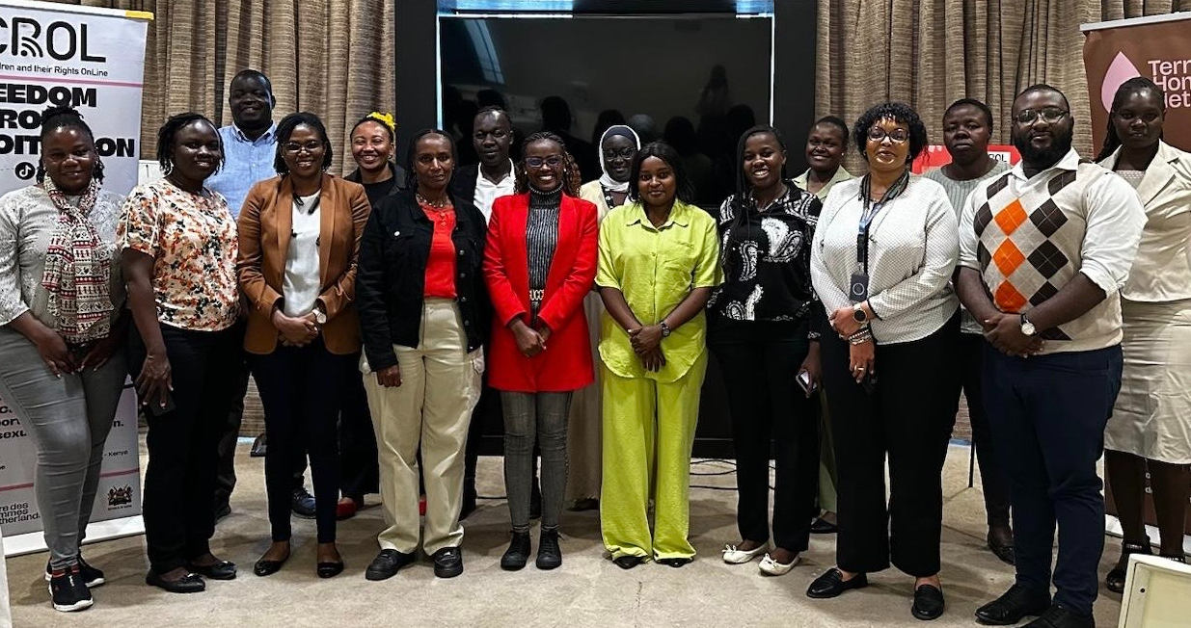
Training
"Collaboration among Probation Officers, Investigating Officers and Children Officers has strengthened investigations by combining our expertise, resulting in stronger evidence, comprehensive support for children, and more robust cases."
— Workshop participant, OCSEA Training
Specialised joint training for police, prosecution and judiciary on OSCE
Notes:
The assessment informed the development of specialised joint training for justice actors in the county.
One specific issue identified was that police officers felt that the investigation of online offences was the responsibility of the directorate of criminal investigation.
Therefore it was important that the training involved actors from the wider system including the judiciary and directorate of public prosecutions - not just police officers so that they could understand each others’ roles and develop a common understanding and improve referral pathways and survivor protection

Slide 17
Findings from the evaluation
Two thirds reported improved ability to identify OSCE cases
80% of prosecutors reported improved understanding of legislation and digital evidence
67% of police officers reported increased knowledge of legal frameworks
75% reported increased confidence in applying trauma informed and child-friendly approaches
Stronger collaboration between police, prosecution and other actors
= a strengthened child protection system and improved justice

Slide 18
Group discussion
Please share your own learning:
Examples of good practice regarding systems approaches from your country/ context
What makes these system approaches work well?
What have been the main challenges in moving to a systems approach?
How could these systems be strengthened?

Slide 19

You can access the Publications using the QR Code

