Slide 1


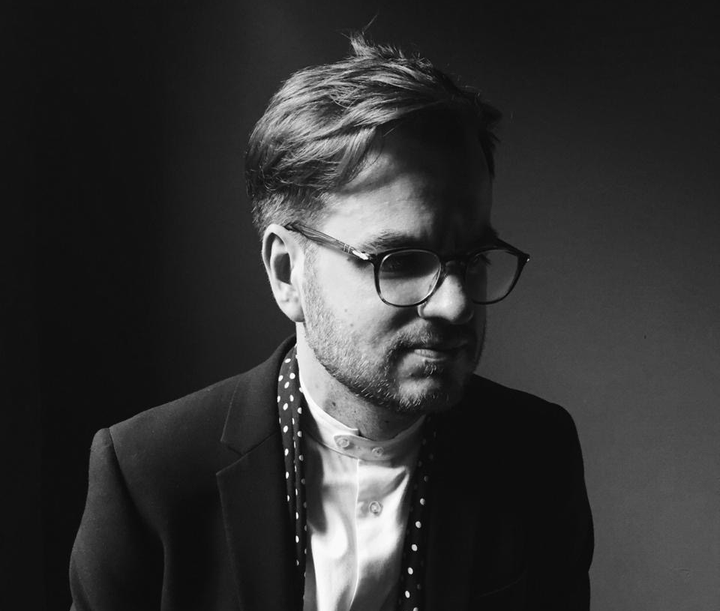
BUILDING THE INVESTMENT CASE FOR
ENDING VIOLENCE AGAINST CHILDREN
an overview, case study examples, and introduction to two new tools
ISPCAN Rise Up Forum, Melbourne, Australia
27 August 2026
SIMON HALVEY
Senior Economist
Cornerstone Economic Research
South Africa

Slide 2
BUILDING THE INVESTMENT CASE FOR ENDING VAC
AGENDA
What is an investment case?
Why an investment case for VAC?
What goes into an investment case?
How are investment cases used?
Introducing investment case tools
Understanding what an investment case is, the purpose it serves, the core questions it seeks to answer, and the typical framework for developing one
Outlining the need for an investment case to end VAC, based on the prevalence data and the associated human and economic costs
Reviewing the approach to develop an investment case for ending VAC, looking at key questions, possible answers and tools of the trade
Illustrating how investment cases are used mobilize funding for ending VAC with various illustrative country case study examples
Introducing the Investment Case Toolkit, developed for the SRSG-VAC, and two new introductory tools developed for ISPCAN
1
2
3
4
5

Slide 3
WHAT IS AN
INVESTMENT CASE?

Slide 4
WHAT IS AN INVESTMENT CASE?
ADVOCACY FOR SPENDING ON SOCIAL SERVICES
Different types of advocacy for increased expenditure on social services – and especially those for child protection
  Foundation: Rights, dignity, equality and protection
    Every child has a claim to safety and protection. These rights, and government obligations, do not depend on whether protecting that child produces a positive economic return.
  Supporting lens: Economic evidence
    Economic arguments can help make selected consequences of violence and benefits of action legible to finance and planning systems, strengthening arguments about prioritisation, affordability and financing.
Rights-based arguments for child protection are ubiquitous and incontrovertible
  Almost all state Constitutions contain specific laws relating to child protection, and most states have dedicated Child Laws
  However, these mandates often remain under-funded – of 155 countries surveyed in the Global Status Report on Ending VAC, 80% had at least one national action plan to end VAC, but less than 25% of those had funded their plans
Evidence-based economic arguments for child protection are far less clear
  Governments must justify spending priorities in an environment of increasing demand for social services coupled with heightened fiscal pressures
  Child protection expenditures are typically a very small part of government budgets and often under-prioritized
  This is largely due to the economics of child protection expenditures – the costs of violence against children (VAC) and the benefits of expenditure to end VAC are not easily observed, nor are they easily quantified in economic terms

Slide 5
WHAT IS AN INVESTMENT CASE?
A DEFINITION
Investment cases use economic evidence to strengthen financing and implementation decisions by examining the costs of inaction, the resources required for a response, and the benefits that action may generate
They provide an additional lens on the case for action, rather than the ethical basis for action

Slide 6
WHAT IS AN INVESTMENT CASE?
THE COMPONENTS OF AN INVESTMENT CASE
There is a
PROBLEM
There is an associated
ECONOMIC LOSS
VS
There is a proposed
SOLUTION
There is a
FINANCIAL COST
of implementation
There is a
BENEFIT
that accrues
The
INVESTMENT CASE

Slide 7
WHY AN INVESTMENT
CASE FOR ENDING VAC?

Slide 8
WHY AN INVESTMENT CASE FOR ENDING VAC?
THE HIGH PREVALENCE OF VAC
246 million children experience violence in and around schools
160 million children are
engaged in child labour
At least 230 million girls
and women alive today have undergone FGM
Violence against children is widespread
More than half of the world’s children are exposed to some form of violence every year
Children’s vulnerability to violence is exacerbated by diverse and often interlinked drivers, including poverty, social inequalities, gender discrimination, conflict, climate change, forced displacement, food insecurity, and harmful social norms
Suicide is the fourth leading
cause of death among
adolescents aged 15 to 19, and almost 46,000 adolescents aged 10 to 19 end their own lives each year – about 1 every
11 minutes
1.6 billion children
regularly face violent
punishment at home; and
more than two thirds of
these children are subjected
to both physical punishment
and psychological
aggression
More than 30% of children
living with disability in 25
countries have experienced
violence, and they are twice
as likely to face neglect and/
or sexual, physical or mental
abuse as children living
without disability
Children account for 38%
of all identified victims of
trafficking
15% of children have
reported cyberbullying
victimization
Around 12 million girls each year are married during childhood
Around 1 in 8 women and girls, and 1 in 11 men and boys, experienced rape or sexual assault before the age of 18
More than 300 million
children per year are victims of online sexual exploitation and abuse
1 in 6 children live in areas
affected by armed conflict

Slide 9
WHY AN INVESTMENT CASE FOR ENDING VAC?
VAC HARMS WELLBEING ACROSS THE LIFE-COURSE
Child 1
Child 2
Conceived by healthy mother
Conceived by mother experiencing IPV
Conception
Born into healthy environment
Low birthweight at birth
Birth
Attends ECCE; on track (ECDI)
Experiences sexual abuse; toxic stress
2 years
Enters primary school
Lower cognitive development; delayed entry
5 years
Full attendance & transition
Absenteeism; poor outcomes; repetition
10 years
Full educational attainment
School dropout; risky behaviours
15 years
Agency, good health & participation
Reduced productivity; NCDs; STIs
20+ years

Slide 10
WHY AN INVESTMENT CASE FOR ENDING VAC?
VAC EXACTS A SIGNIFICANT SOCIETAL TOLL
Economic cost
Economic cost of child abuse and neglect
*Captures some, but not all, of these consequences
Inter-generational impacts
Impacts on the broader economy
Reductions in the productive capacity in the economy
Reductions in labour market engagement and participation
Lost tax revenues from reduced output and income levels
Reductions in macro-level measures of human development and human capital
Impacts on the achievement of relevant international development targets
Impacts on government services
Increased use of health sector services, inpatient, outpatient equipment and medical supply costs
Increased engagement with justice sector, policing incarceration and legal proceeding costs
Increased engagement with social welfare services, case management, staff and admin costs
Increased rates of enrolment in special education and increased rates of grade repetition in schools
Impacts on children’s rights, safety & wellbeing
Higher incidence of illness, injury, mortality and morbidity
Reductions in cognitive and human capital development; productivity losses
Lower educational attainment; higher rates of absenteeism and dropout
Reductions in health-related and social quality of life measures
Reduced safety, dignity and agency; increased pain and suffering
Child abuse and neglect

Slide 11
WHY AN INVESTMENT CASE FOR ENDING VAC?
VAC HAS A SIGNIFICANT ECONOMIC COST
Country | Total Cost of VAC Estimate
 | % GDP | % Government Health Budget
Australia | 1.94% | 25.32%
Cambodia | 1.10% | 77.64%
Canada | 1.67% | 23.66%
China | 1.70% | 76.23%
Germany | 1.17% | 15.17%
Ghana | 0.79% | 49.31%
Italy | 0.81% | 11.58%
Japan | 1.00% | 11.21%
Malawi | 2.85% | 170.08%
Nigeria | 2.65% | 599.72%
South Africa | 5.39% | 126.36%
Turkey | 7.00% | 199.07%
USA | 10.96% | 129.36%
Vanuatu | 0.67% | 33.57%
Global | 8.91% | 155.50%
The total economic cost of VAC is significant – estimated at over USD 7 trillion in 2014, equivalent to nearly 9% of global GDP and more than combined total government expenditure on health, primary and secondary education globally that year
Data from country-level studies of the economic cost of VAC are similarly substantial, with national-level estimates of the cost of VAC as high as 11% of GDP and annual costs of VAC significantly exceeding annual government expenditure on health in several countries
This highlights the pervasive nature of VAC and its associated costs and the need for global attention to be given to prevention

Slide 12
WHY AN INVESTMENT CASE FOR ENDING VAC?
PREVENTING VAC CAN GENERATE SUBSTANTIAL SOCIAL AND ECONOMIC BENEFITS
Country | Programme | Outcome
New Zealand | Incredible Years Parenting Programme | BCR 3.75
USA | SafeCare | BCR 14.65
Sweden | Four separate programmes | BCR 5.46 - 16.13
Turkey | Mother Child Education Program | BCR 5.91-8.14
Kenya | Msingi Bora Parenting Intervention | BCR 10.6 -15.5
India | Life Skills Education and Youth Information Centres programmes | BCR 21
USA | Communities that Care | BCR 5.30
Netherlands | KiVa | BCR 4.04 - 6.72
UK | Domestic Violence Perpetrator Programme | BCR 2.05
USA | Promoting First Relationships | BCR 4.13-5.19
USA | Child-Parent Centers and Nurse-Family Partnership | BCR 1.73-6.37
There is significant evidence in the literature that interventions designed to prevent VAC can yield benefits that significantly exceed the initial costs of implementation
These positive returns on investment can strengthen the fiscal case alongside existing rights, need, equity, effectiveness and feasibility arguments
The implementation costs of many such interventions are also often small relative to national and departmental budgets, and so therefore require minimal increases to or reallocation of domestic spending in order to implement

Slide 13
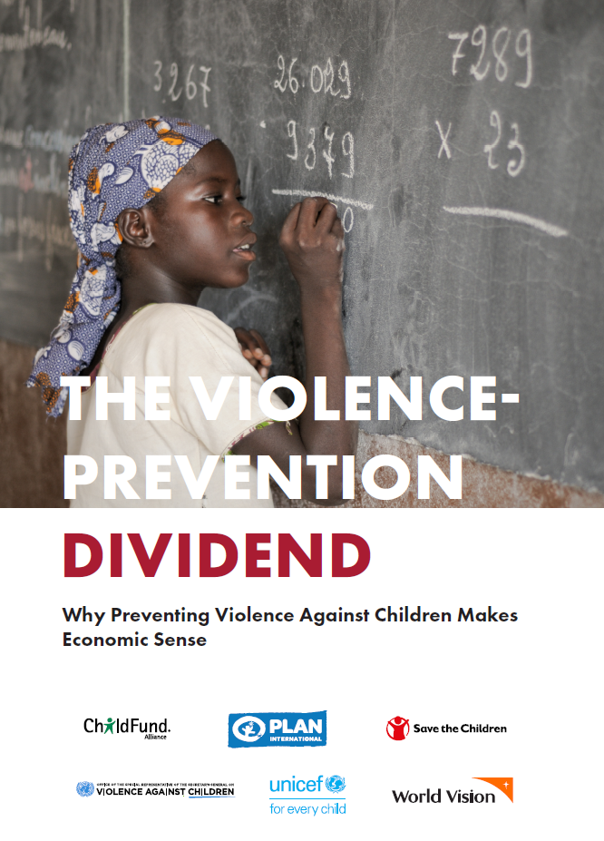
WHY AN INVESTMENT CASE FOR ENDING VAC?
THE VIOLENCE PREVENTION DIVIDEND
Investment in proven, evidence-based violence prevention and response programmes can improve child wellbeing, and remove critical barriers to children achieving their health, educational and developmental potential
The economic benefits flowing from such investments accrue through multiple mechanisms:
  All children will reach their full potential, expanding the supply of productive labour market participants to the economy, boosting per capita incomes and increasing domestic demand
  Existing health, education and social protection spending will be more effective, as children’s development will not be hindered by the impact of violence
  Costs associated with the consequences of VAC on health, education, child protection and criminal justice systems will be reduced, allowing governments to use funds more productively
  The vicious intergenerational cycle of violence, and its links to poverty, will be broken, improving the economic trajectories of children and their parents and communities
The sum of these benefits represents a social and economic dividend that will accrue to society, if governments invest in programmes to prevent and respond to VAC

Slide 14
WHAT GOES INTO AN INVESTMENT CASE?

Slide 15
WHAT GOES INTO AN INVESTMENT CASE?
THE INVESTMENT CASE FOR ENDING VAC
There is a
PROBLEM
There is an associated
ECONOMIC LOSS
VS
There is a proposed SOLUTION
There is a
FINANCIAL COST
of implementation
There is a
BENEFIT
that accrues
The
INVESTMENT CASE
for preventing and responding to VAC

Slide 16
WHAT GOES INTO AN INVESTMENT CASE?
THE PROBLEM
There is an associated
ECONOMIC LOSS
VS
There is a proposed SOLUTION
There is a
FINANCIAL COST
of implementation
There is a
BENEFIT
that accrues
There is a
PROBLEM
Key Question
Possible Answers
Tools of the Trade
Nature, scale and distribution of VAC
Children most affected
Gaps in prevention and response services
Current government and partner spending
Key system bottlenecks
Situation analysis
Prevalence analysis using survey data
Service mapping
Child protection systems assessment
Budget/public expenditure analysis
Stakeholder consultations
What is the problem?

Slide 17
WHAT GOES INTO AN INVESTMENT CASE?
THE ECONOMIC COST OF VAC
There is a
PROBLEM
VS
There is a proposed SOLUTION
There is a
FINANCIAL COST
of implementation
There is a
BENEFIT
that accrues
There is an associated
ECONOMIC LOSS
Key Question
Possible Answers
Tools of the Trade
The toll of VAC on victims, families, communities and society
The financial cost of VAC to governments
The economic cost of VAC to society and the broader economy
The intergenerational impacts of VAC
Rights-based analysis
Evidence review
VAC impact studies
Burden-of-disease analysis
Cost-of-inaction modelling
ISPCAN’s Cost of VAC tool
What wider harms and societal consequences does the problem generate?

Slide 18
WHAT GOES INTO AN INVESTMENT CASE?
THE PROPOSED SOLUTION
There is a
PROBLEM
There is an associated
ECONOMIC LOSS
VS
There is a
FINANCIAL COST
of implementation
There is a
BENEFIT
that accrues
There is a proposed SOLUTION
Key Question
Possible Answers
Tools of the Trade
Integrated prevention and response strategies
Evidence-informed intervention packages
Strengthened child protection systems
Stronger social service workforce
Improved referral, case management and survivor-centred services
Regional/local pilot studies
INSPIRE framework
National Action Plans
Intervention prioritization
Workforce planning
Bottleneck analysis
How could the problem be
addressed?

Slide 19
WHAT GOES INTO AN INVESTMENT CASE?
THE FINANCIAL COST OF IMPLEMENTATION
There is a
PROBLEM
There is an associated
ECONOMIC LOSS
VS
There is a proposed SOLUTION
There is a
BENEFIT
that accrues
There is a
FINANCIAL COST
of implementation
Key Question
Possible Answers
Tools of the Trade
Phased costed implementation plan
Costed implementation scenarios
Estimated cost of each intervention and system-strengthening component
Key cost drivers
Affordability and financing gaps
Ingredients-based costing
Activity-based costing
Unit cost analysis
Scenario modelling
Budget impact analysis
Financial gap analysis
What is the cost of the proposed solution?

Slide 20
WHAT GOES INTO AN INVESTMENT CASE?
THE BENEFITS OF IMPLEMENTATION
There is a
PROBLEM
There is an associated
ECONOMIC LOSS
VS
There is a proposed SOLUTION
There is a
FINANCIAL COST
of implementation
There is a
BENEFIT
that accrues
Key Question
Possible Answers
Tools of the Trade
VAC cases prevented or better managed
Improved health, learning and wellbeing
Avoided service costs
Human capital and productivity gains
Positive spillovers across government systems
Coverage modelling
Impact modelling
Cost-benefit analysis
Cost-effectiveness analysis
Return-on-investment analysis
ISPCAN’s ROI Tool
What are the benefits of implementing the solution?

Slide 21
HOW ARE INVESTMENT
CASES USED?

Slide 22
HOW INVESTMENT CASES ARE USED
CASE STUDY – ZAMBIA
VS
PROBLEM
ECONOMIC LOSS
SOLUTION
FINANCIAL COST
BENEFIT

Slide 23

HOW INVESTMENT CASES ARE USED
CASE STUDY – ZAMBIA
VS
ECONOMIC LOSS
SOLUTION
FINANCIAL COST
BENEFIT
PROBLEM
Experience of childhood violence among males, by type
50.3% of males and 49.0% of females in Zambia experienced some form of violence prior to the age of 18 years
Prevalence of sexual violence in childhood was higher for girls (23.1%) than for boys (11.7%), while prevalence of physical and emotional violence was higher for boys (38.8% and 19.7%) than for girls (31.4% and 14.8%)
Rates of polyvictimization were high for both boys and girls, with around 1 in 6 children experiencing multiple forms of violence
Experience of childhood violence among females, by type

Slide 24
HOW INVESTMENT CASES ARE USED
CASE STUDY – ZAMBIA
VS
PROBLEM
SOLUTION
FINANCIAL COST
BENEFIT
ECONOMIC LOSS
Summary of the economic and social costs of VAC
These high rates of VAC have significant impacts in Zambia – on the individual child victims and their families; on government services in the social sectors; and on the broader economy
It is estimated that, across these various pathways, the total economic cost of VAC in Zambia amounts to ZMK 40 362.9 million, equivalent to 9.12% of GDP annually

Slide 25
HOW INVESTMENT CASES ARE USED
CASE STUDY – ZAMBIA
VS
PROBLEM
ECONOMIC LOSS
FINANCIAL COST
BENEFIT
SOLUTION
The proposed solution to the preceding problems involves strengthening the social service workforce, ensuring its structure is fit for purpose, and increasing its size
The table to the left presents the envisaged roll-out plan for the systematic strengthening of the social service workforce
Rollout of staff in the systematic strengthening scenario

Slide 26
HOW INVESTMENT CASES ARE USED
CASE STUDY – ZAMBIA
VS
PROBLEM
ECONOMIC LOSS
SOLUTION
BENEFIT
FINANCIAL COST
Cost of the systematic strengthening scenario
The total new funding required is around ZMK 200 million per year which is within the bounds of what is fiscally affordable
The annual operating cost at full rollout is ZMK1.7 billion per year which is only 0.98% of the total government budget
Total new funding required each year to implement the systematic strengthening scenario

Slide 27
HOW INVESTMENT CASES ARE USED
CASE STUDY – ZAMBIA
VS
PROBLEM
ECONOMIC LOSS
SOLUTION
FINANCIAL COST
BENEFIT
Modelled impact of 90-90-90 VAC service targets on VAC prevalence
Type of VAC | Baseline | Intervention | Difference
Males
Sexual | 11.70% | 7.57% | -4.13%
Physical | 38.79% | 23.47% | -15.32%
Emotional | 19.64% | 11.93% | -7.72%
Females
Sexual | 23.07% | 15.63% | -7.43%
Physical | 31.36% | 18.11% | -13.25%
Emotional | 14.75% | 8.75% | -6.00%
The potential impact of historical achievement of improved coverage of child protection services on VAC outcomes was modelled
Under this model, the total economic cost of VAC drops from ZMK40.4 billion, or 9.12% of GDP, to ZMK17.7 billion, or 4.00% of GDP – a total cost reduction of 56.2%, or ZMK22.7 billion, equivalent to 5.12% of GDP
Summarised modelled impact of 90-90-90 VAC service targets on the total cost of VAC
Cost category (ZMK millions) |  | Initial Cost |  | Revised Cost |  | Cost Reduction
Category | Type | Total | % of GDP | Total | % of GDP | Total | % of GDP
Direct | Medical | 3 185.7 | 0.72 | 1 334.7 | 0.30 | 1 851.0 | 0.42
 | Non-medical | 187.5 | 0.04 | 112.4 | 0.03 | 75.1 | 0.02
Indirect | Tangible | 6 679.1 | 1.51 | 3 109.7 | 0.70 | 3 569.4 | 0.81
 | Intangible | 30 310.5 | 6.85 | 13 141.3 | 2.97 | 17 169.2 | 3.88
Total cost of VAC |  | 40 362.9 | 9.12 | 17 698.1 | 4.00 | 22 664.8 | 5.12

Slide 28
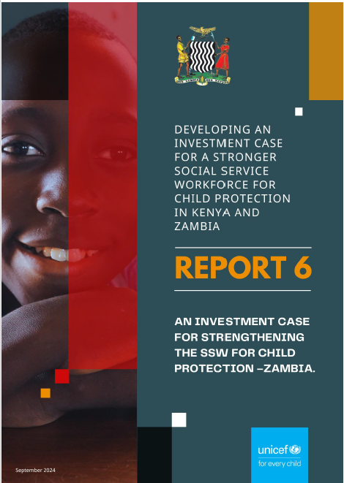

HOW INVESTMENT CASES ARE USED
CASE STUDY – ZAMBIA

Slide 29
INVESTMENT CASE TOOLS

Slide 30
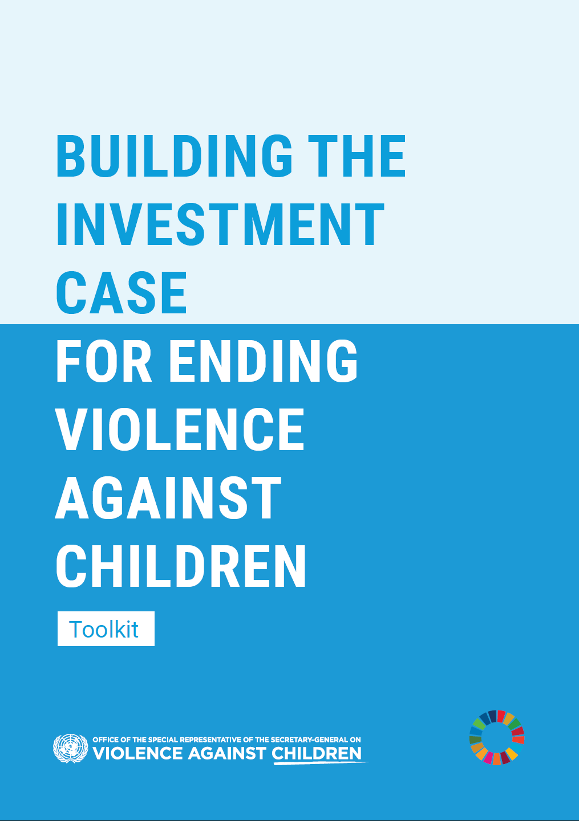
INVESTMENT CASE TOOLS
DEVELOPING A FULL CASE – THE INVESTMENT CASE TOOLKIT
To enable countries to generate their own full investment case evidence in support of increased financing for integrated services for child protection OSRSG-VAC has developed a toolkit titled Building the Investment Case for Ending Violence Against Children – Toolkit
Using this Toolkit to develop their own country-led investment cases will enable States to support existing rights-based arguments with a clear, country-context specific evidence-based economic argument for investing in children, support prioritization of key interventions, identify areas of fragmentation, and ultimately demonstrate spending on child protection as not only a moral imperative for protecting the fundamental rights of every child, but also a sound economic investment

Slide 31
INVESTMENT CASE TOOLS
STARTING THE CONVERSATION – TWO NEW TOOLS
VS
PROBLEM
ECONOMIC LOSS
SOLUTION
FINANCIAL COST
BENEFIT

Slide 32
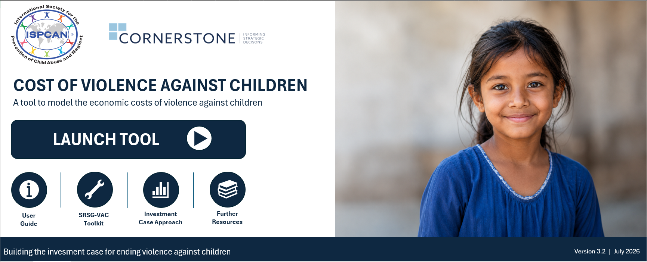
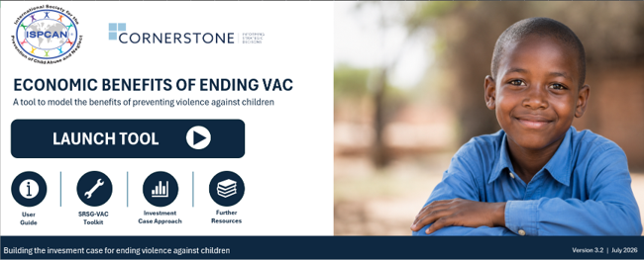
INVESTMENT CASE TOOLS
STARTING THE CONVERSATION – TWO NEW TOOLS
PROBLEM
ECONOMIC LOSS
VS
SOLUTION
BENEFIT
FINANCIAL COST
COST OF VAC TOOL
RETURN ON INVESTMENT TOOL
What might VAC be costing the country?
What might society gain from preventing VAC?
ESTIMATES:
Health-related impacts of VAC
Economic losses associated with VAC
Overall cost and % of GDP
Contributions by VAC type and outcome pathway
ESTIMATES:
Cost of a hypothetical investment
Potential economic benefits of implementation
Benefit-cost ratio and returns on investment
QUANTIFYING THE COST OF INACTION
QUANTIFYING THE BENEFIT OF ACTION
Both tools – still under ongoing development – generate indicative, high-level, order-of-magnitude estimates of selected, monetizable impacts, based on available data and explicit assumptions. They support initial analyses, advocacy and investment case discussions, but do not replace dedicated country-level studies, nor do they capture all relevant rights-based impacts, costs and benefits.

Slide 33
TURNING EVIDENCE INTO FINANCED ACTION

Slide 34
TURNING EVIDENCE INTO FINANCED ACTION
KEY AGENTS OF CHANGE & THEIR ROLES
Child protection is inherently multisectoral, so securing greater investment requires action from actors across government and beyond. Their roles are complementary, and engagement should occur throughout the development of the investment case:
Government leaders: Establish the mandate, appoint an accountable lead and champion an integrated response.
Finance, planning and budget ministries: Assess affordability and financing needs, and connect the investment case to plans and budgets.
Sector ministries and local authorities: Translate the proposed response into services, activities, staffing requirements and performance targets.
Civil society, survivors and oversight bodies: Bring lived experience into the process, safeguard rights and equity, build demand and strengthen accountability.
Researchers and development partners: Strengthen the evidence base, analytical capacity and implementation support, while aligning assistance with national priorities.

Slide 35
TURNING EVIDENCE INTO FINANCED ACTION
INTEGRATE THE INVESTMENT CASE INTO PUBLIC FINANCE MANAGEMENT
Advocacy shouldn’t merely target a once-off increase in funding, but rather seek to embed prevention and response within the routine systems through which governments set priorities, allocate resources, manage personnel and monitor performance:
National planning: Make prevention a national and sector priority
Economic growth strategy: Frame prevention as an investment in human capital and economic growth
Departmental planning: Include clear activities, outputs and performance targets
Budget reforms: Make prevention spending and results visible in programme budgets
Budget formulation: Translate costed plans into programmes, budget lines and medium-term needs
Budget approval: Use investment case evidence to secure adequate allocations
Budget execution: Track releases, spending and implementation bottlenecks
Budget tagging: Identify and track prevention expenditure across government
Human resource management: Establish workforce requirements and sufficient funded posts

Slide 36
THANK YOU
SIMON HALVEY
Senior Economist
Cornerstone Economic Research
South Africa

