Slide 1

THANK YOU for joining today’s session
We apologize for any confusion if you are joining us early.
Because the United States and Canada experienced our biannual time change to Daylight Savings Time on Sunday 3/12 and the rest of the globe has not, the timing of our presentation has been affected.
For United States and Canada registrants, the time of the webinar will now begin at 11:00AM EDT (Eastern Daylight Time)
Although we are hope that you will join us at 11:00am EDT using the same ZOOM join link to attend in person, please do not worry if you are now unable to do so because a full recording of the presentation will be sent to all registrants after the session.

Slide 2
today’s session

Slide 3
Empowering Children for personal safety
Moderator:
Jane Estes
Knowledge & Development Manager - ISPCAN
Pooja Taparia
Founder and Chief Executive of Arpan
Dr. Neha Sharma
Communication and Extension at ARPAN

Slide 4
Tips for making the most of Today’s session please engage with us!
As you listen to the presentations, make note of your questions and comments to share at the open dialog part of this session or add them to the Chat Box during the session
Please take a moment to introduce yourself to other attendees and the presenters in the Chat Box.
Participate in our Live Polling – Please have your phones ready to scan a QR code to participate in our audience SLIDO polling questions.
Please note: A recording of this panel discussion + presentation slides + links to the resources shared today will be sent directly to you after the session today in a follow up email.

Slide 5
Goal for today’s session
Highlight Arpan’s Free Online Courses for Children, Adolescents and adults
Share the journey from conducting offline sessions to building online/digital content
Provide resources that equip professionals and caregivers to facilitate these online courses

Slide 6


Join at slido.com
#1729220
ⓘ Start presenting to display the joining instructions on this slide.

Slide 7

What Country are you joining us from today?
ⓘ Start presenting to display the poll results on this slide.

Slide 8
What is the profession/discipline you are representing today?
ⓘ Start presenting to display the poll results on this slide.

Slide 9
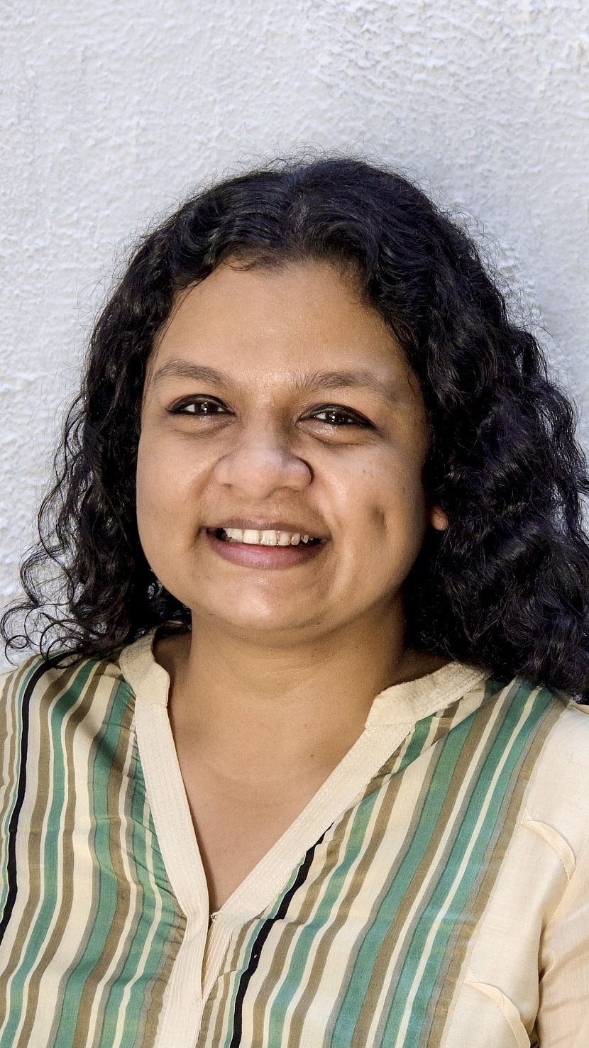
Pooja Taparia
Founder and Chief Executive of Arpan
Arpan is a globally-recognized, award-winning NGO working towards the elimination of Child Sexual Abuse (CSA) in India. Based in Mumbai, Arpan is India’s largest NGO providing CSA Prevention and Intervention services for both children and adults.
As a leader, Pooja embodies the spirit of the modern-day social entrepreneur and has grown Arpan from a 3-person startup into a global thought leader in the CSA space, with innovative impact models that work with a range of stakeholders, from children and parents to state bodies and teachers.
Since 2007, Pooja has led Arpan to impact over 2.5 million children and adults, and receive 6 National and 2 International Awards, including the C. Henry Kempe Award by ISPCAN and the WISE Award by Qatar Foundation for exemplary work.

Slide 10
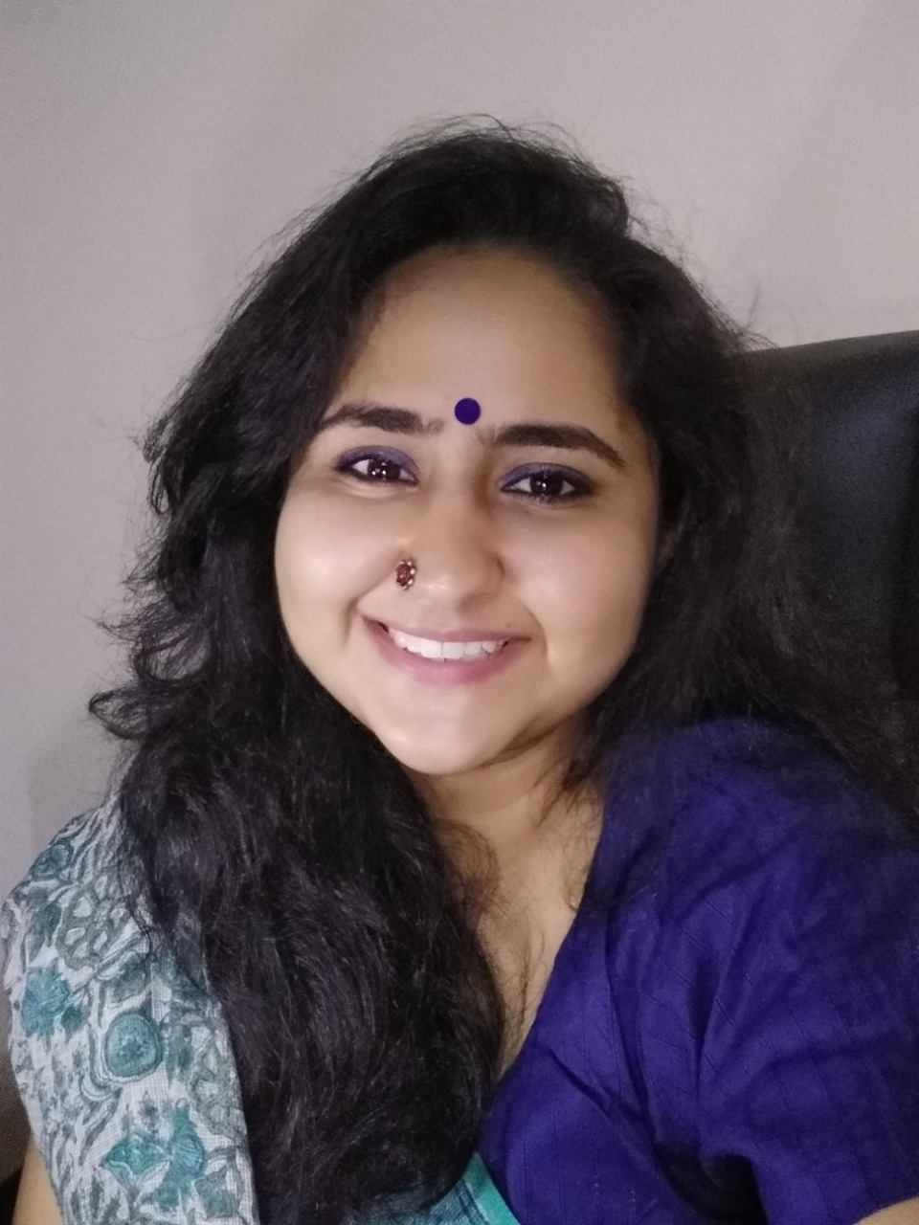
Dr. Neha Sharma
PhD in Development
Communication and Extension for aRPAN
Dr. Sharma has over 10 yrs. of experience in the development sector. She has been part of various health and gender-based research studies.
She is a life skills trainer and former associate Prof in Delhi University.
She has been working with Arpan for the last 5 years, where she actively facilitates trainings and contributes to developing content.

Slide 11
Empowering Children for Personal Safety
Pooja & Neha

